Slide 1
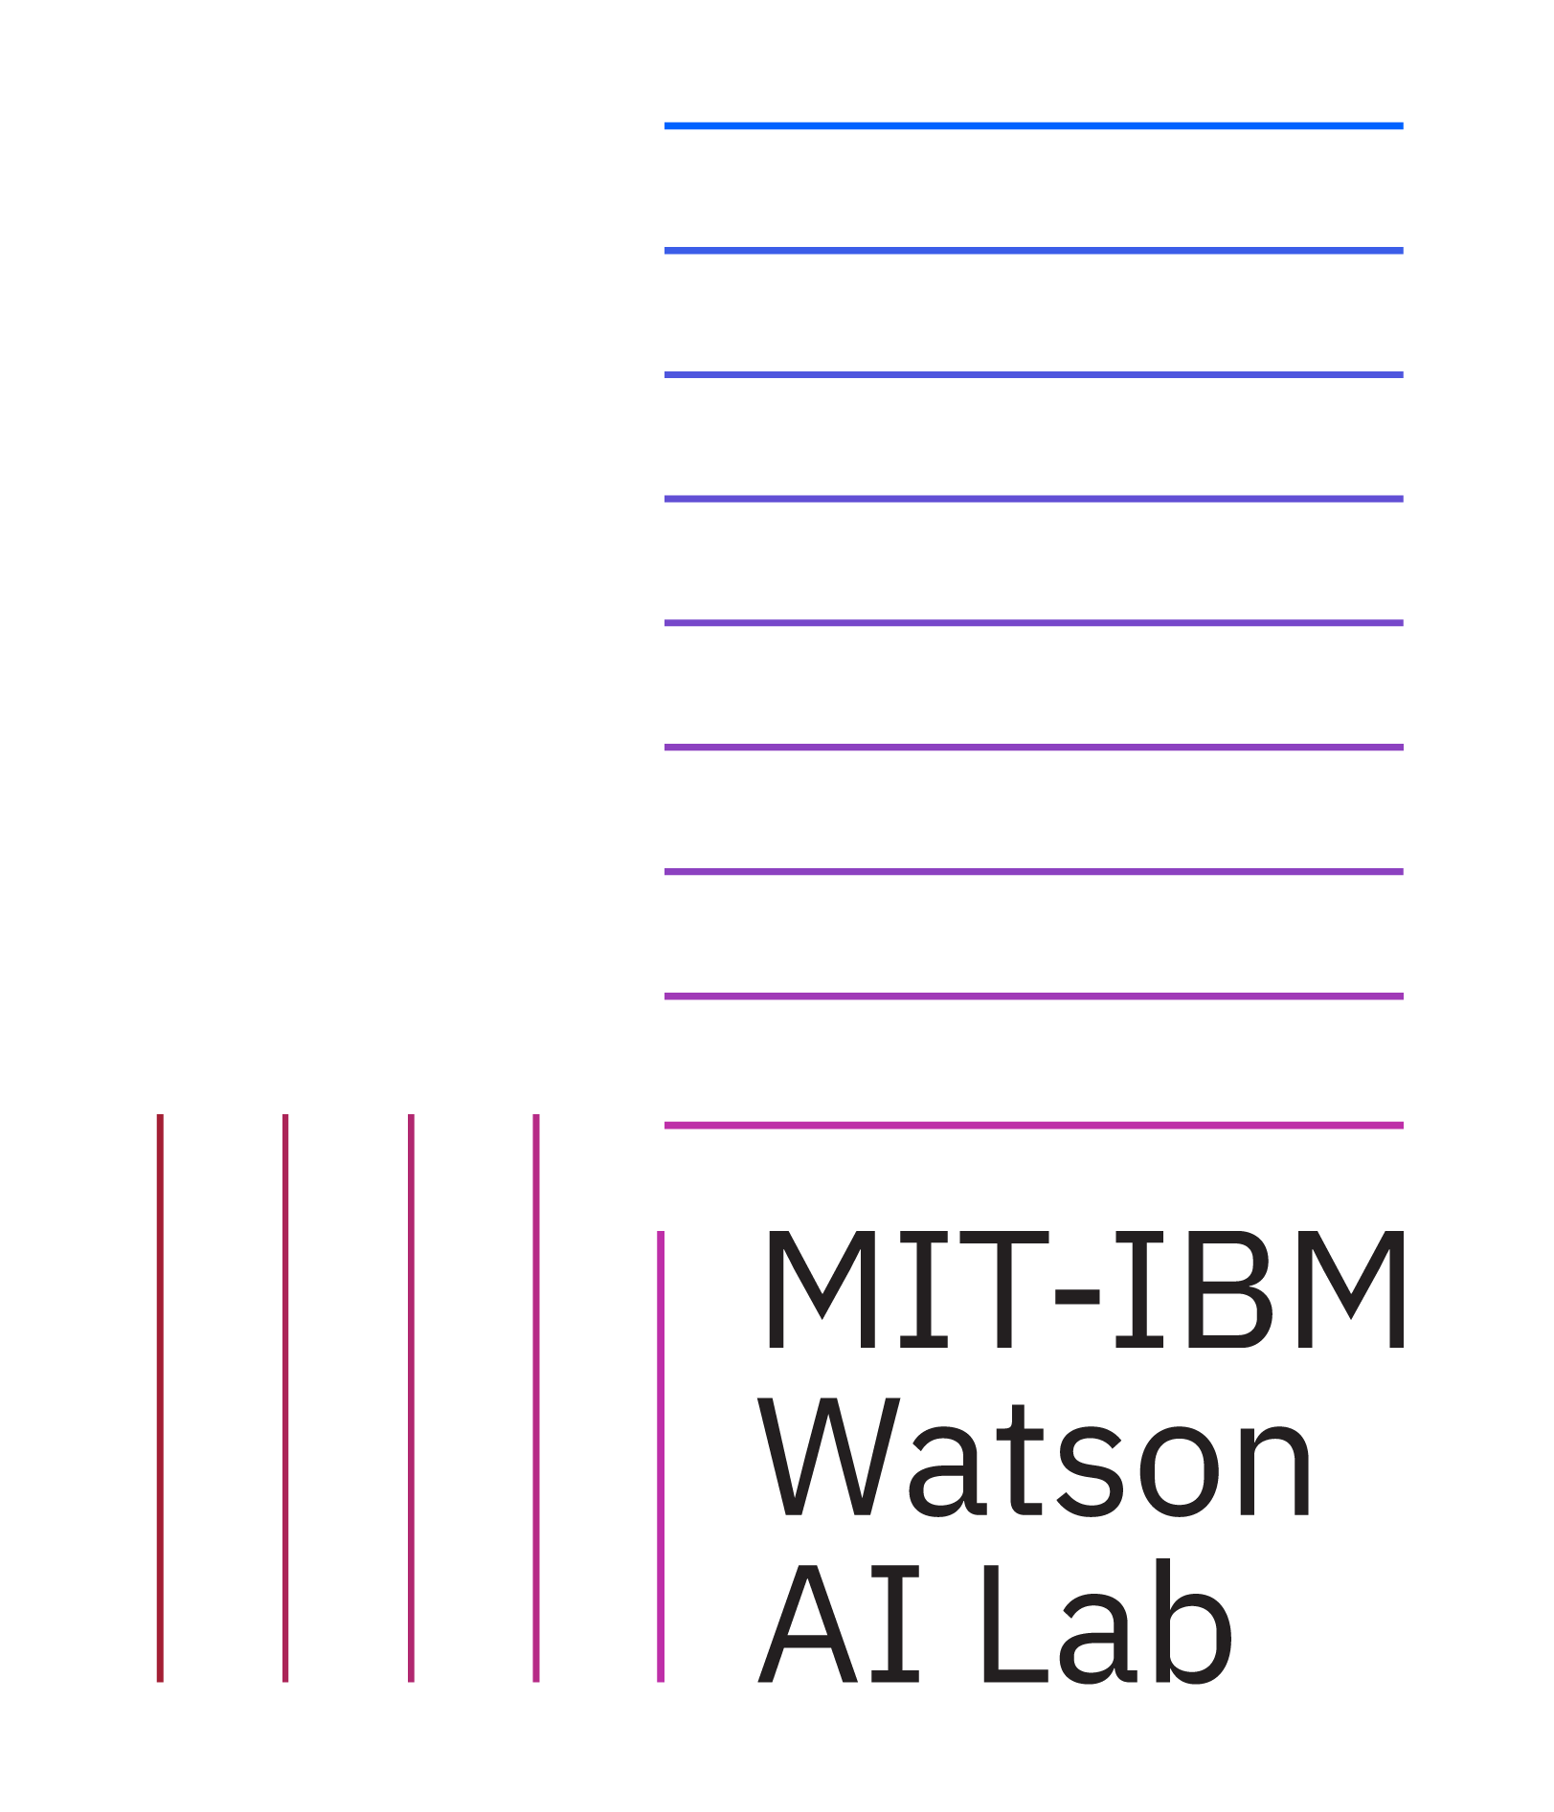
Ablate, Variate, and Contemplate: Visual Analytics for Discovering Neural Architectures
Dylan Cashman¹, Adam Perer², Remco Chang¹, Hendrik Strobelt³
¹Tufts University
²Carnegie Mellon University
³MIT IBM Watson AI Lab

Slide 2
How can we help data scientists select Convolutional Neural Network (CNN) architectures?

Slide 3
Example: Graffitti Classification
Leon is a data scientist that wants to use ML for classifying political graffiti to compare it across many countries
There may be tradeoffs involved in selecting the model:
Accurate
Small – fits on mobile phones
Source: https://www.filmsforaction.org/articles/political-graffiti/

Slide 4
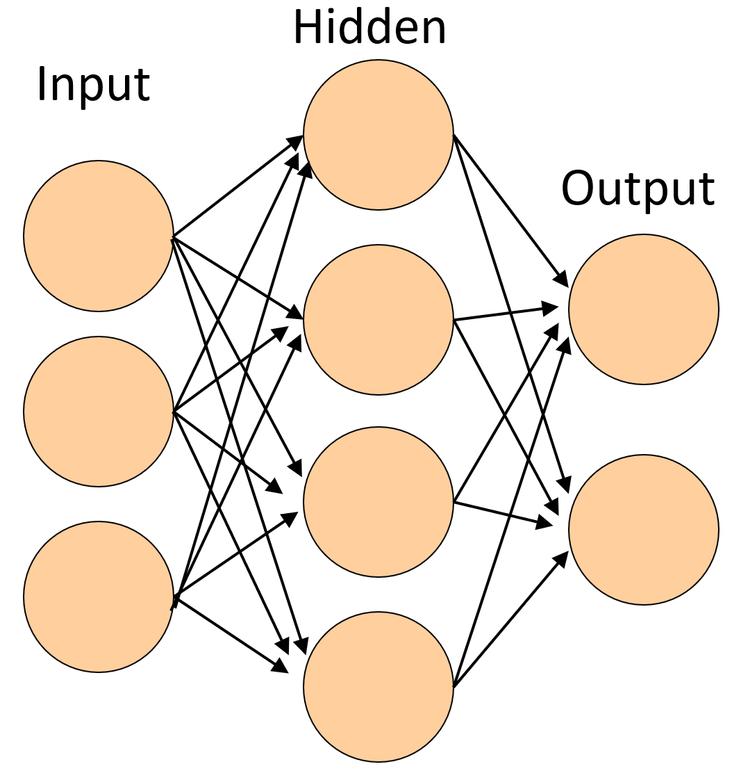
Neural Network

Slide 5
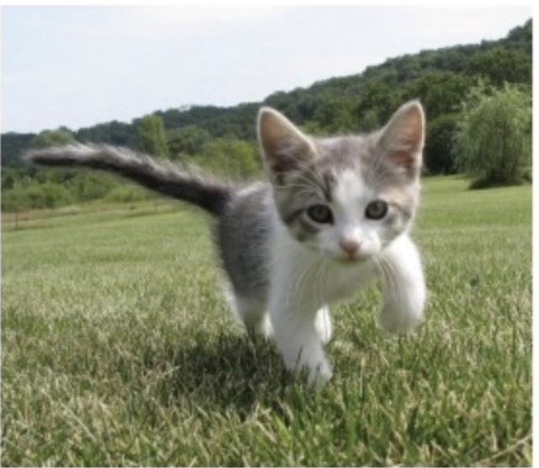
Cat (74% confident)
Lion (10% confident)
Statue (4% confident)
Dog (4% confident)
…

Slide 6
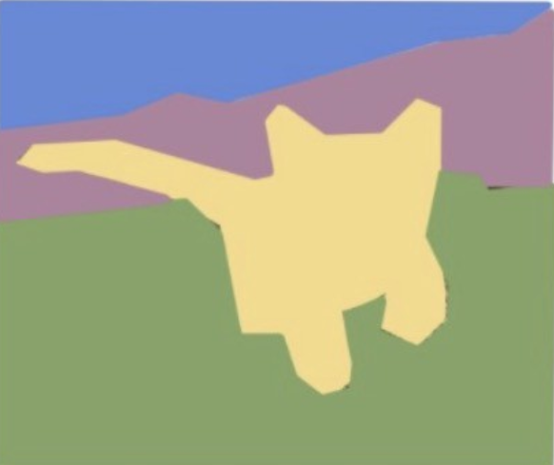

Slide 7
A young cat is sitting on a field of grass

Slide 8
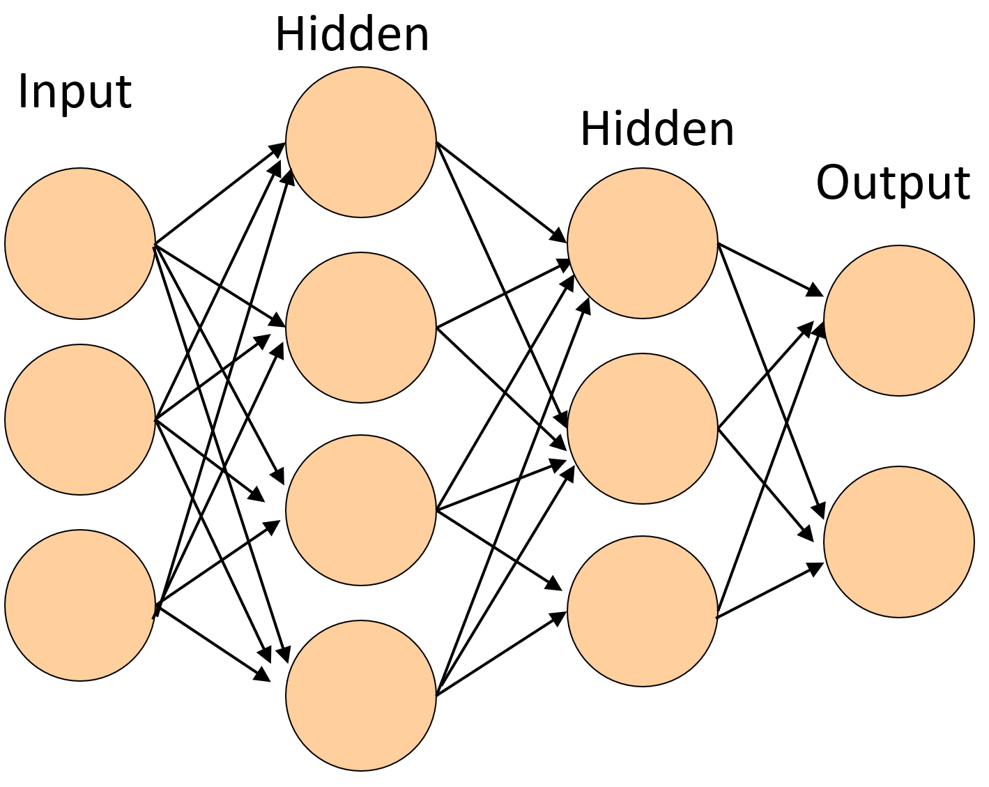
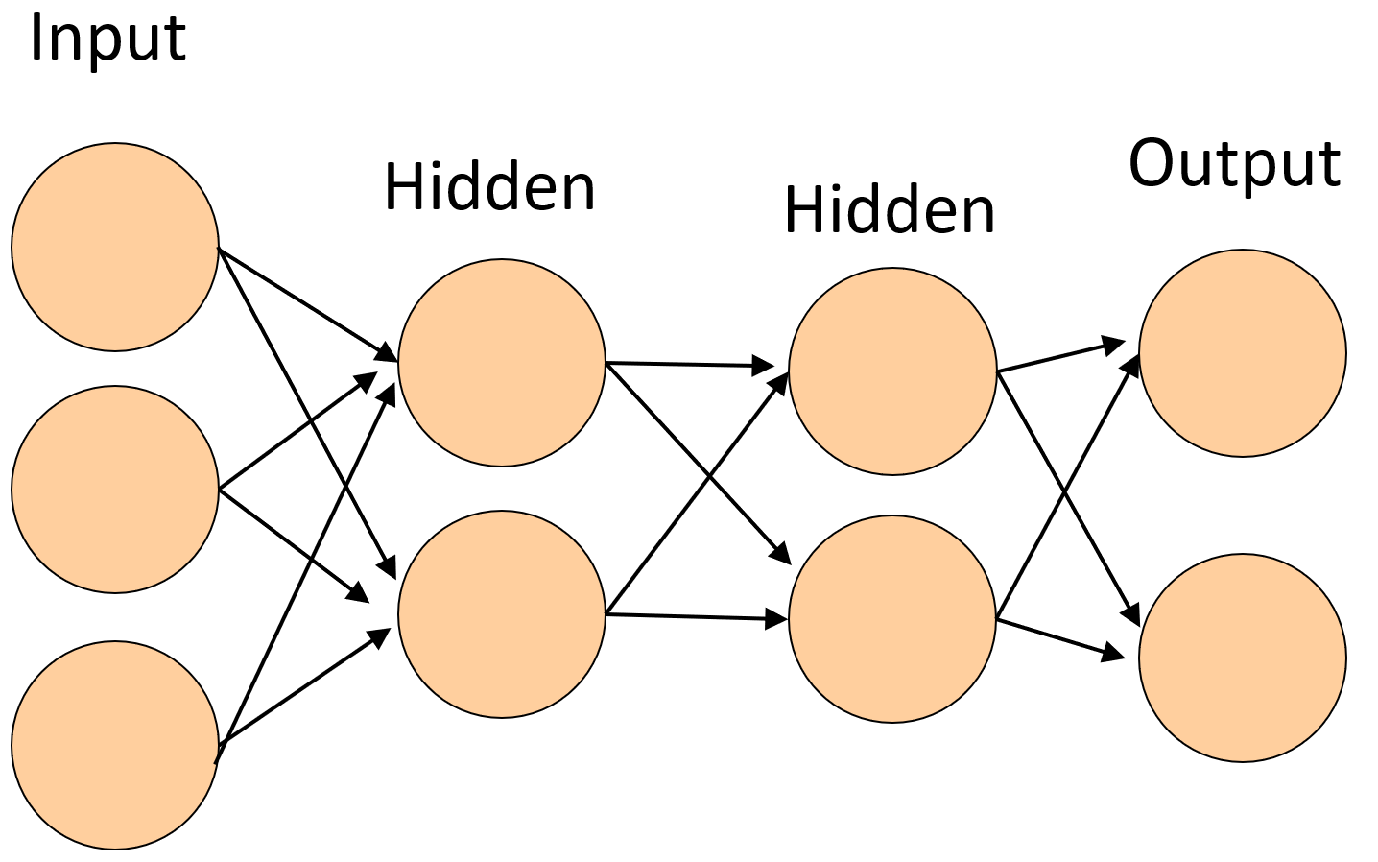
Model Architecture and Parameters
# of filters
size of filters
stride
...

Slide 10
Bear (68% confident)
Lion (10% confident)
Statue (4% confident)
Dog (4% confident)
…
Mule (71% confident)
Lion (10% confident)
Statue (4% confident)
Dog (4% confident)
…
Bike (55% confident)
Lion (10% confident)
Statue (4% confident)
Dog (4% confident)
…

Slide 11
We want to make it easier for data scientists to choose their own model and make tradeoffs between accuracy and model size.

Slide 12
1. Global overview of CNN model space
2. Human-guided local exploration via semi-automated search
3. Space-efficient visual encoding for neural networks

Slide 13
Related Work autoML
Thousands of GPU hours
autoML
Difficult to Customize
Difficult to Interpret
Notes:
Separate out time and cost into two different points
Additional problems; difficult to customize, and a black box around black boxes, not actually contributing to interpretability. Black box searching for black box functioning the best.

Slide 14
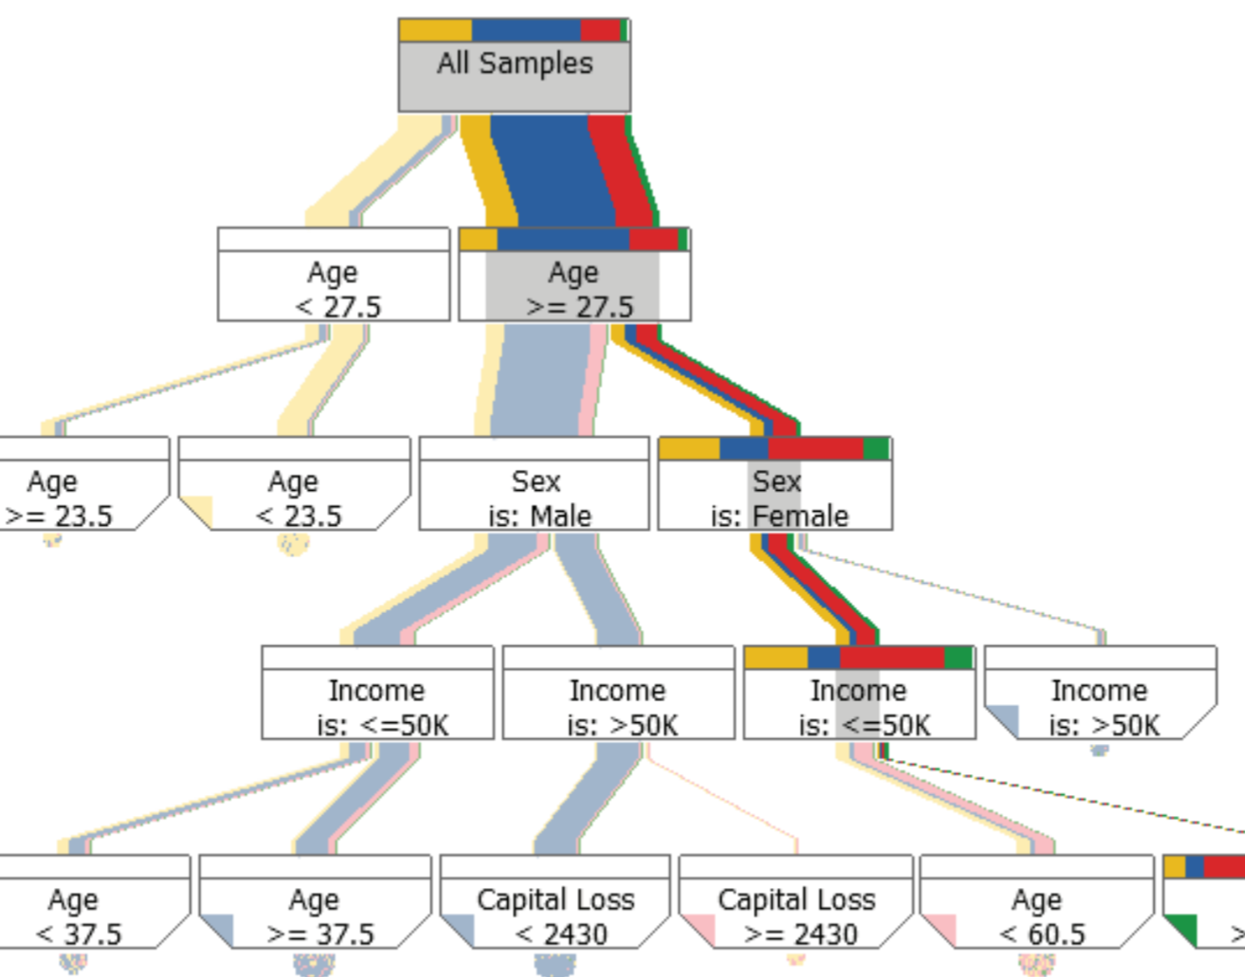
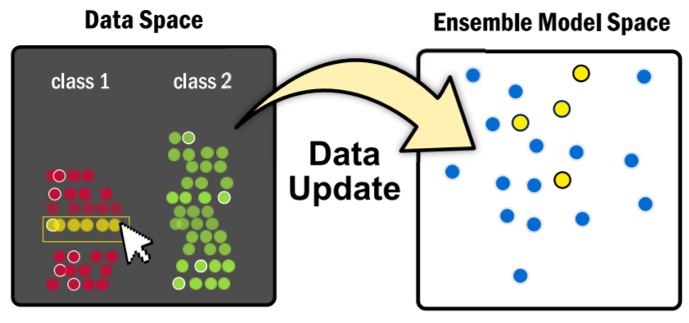
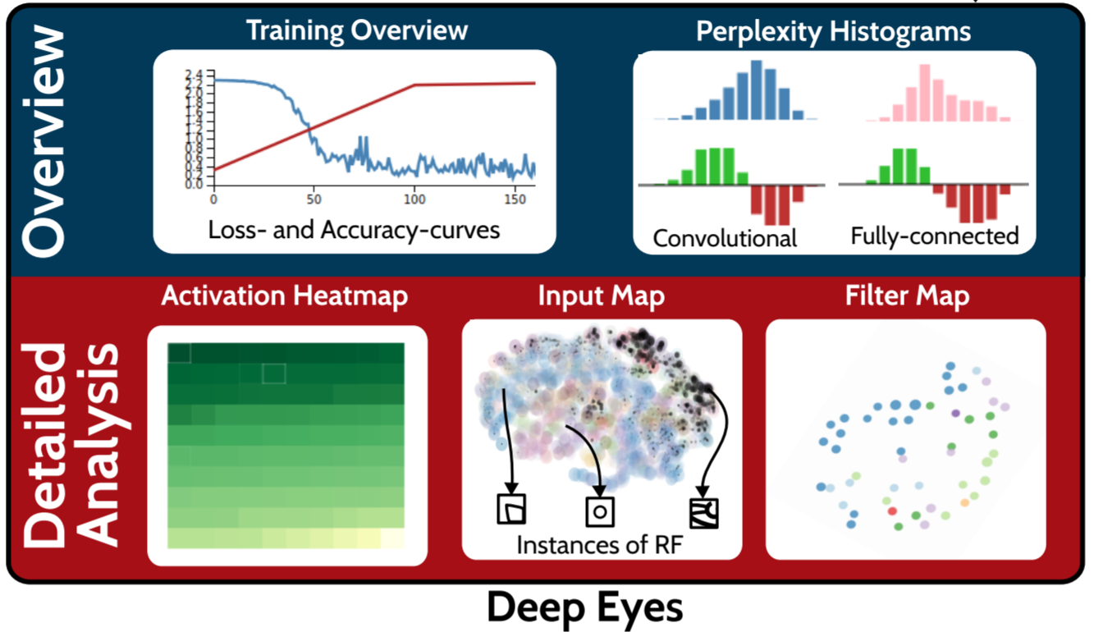
Related Work Visual Analytics
Model Steering
Liu 2017
Liu 2018
Wongsuphasawat 2018
Yosinski 2018
Kahng 2018
Olah 2018
Muhlbacher 2018
Schneider 2017
Cavallo & Demiralp 2019
Das 2019
Cashman 2019
Kwon 2018
Brown 2014
Muhlbacher & Piringer 2013
Not Applicable
to Architecture Search
Assume Architecture Already Found
Pezzotti 2017
Deep Learning
Notes:
Want to make sure that I don’t leave out all the citations we have, so just add a list.

Slide 15
We can use visualization to help the user navigate the model space.
But first, we need to know how experts navigate the model space.

Slide 16
Task Analysis
4 model builders
3 PhD students, 1 Industry
60 minute interview

Slide 17
Task Analysis
^{Goal}
Determine how experts choose model architectures
^{Interview}
How do you start?
Common Obstacles?
What do you visualize?
Notes:
Remove the red boxes
Not a consistent color strategy for presentation

Slide 18
Start With Relevant Baseline…
T1: Global Search
Quickly search visual overview of models.
T2: Local Exploration
Generate local, constrained searches near baseline
T3: Visually Compare
Understand small differences in architectures.

Slide 19
… Fine Tune The Baseline
T1: Global Search
Quickly search visual overview of models.
T2: Local Exploration
Generate local, constrained searches near baseline
T3: Visually Compare
Understand small differences in architectures.
Add a layer!
Change
filter
size!

Slide 20
Interpret Change in Performance
T1: Global Search
Quickly search visual overview of models.
T2: Local Exploration
Generate local, constrained searches near baseline
T3: Visually Compare
Understand small differences in architectures.

Slide 21
T1: Quickly search for baseline architectures through an overview of models.

Slide 22
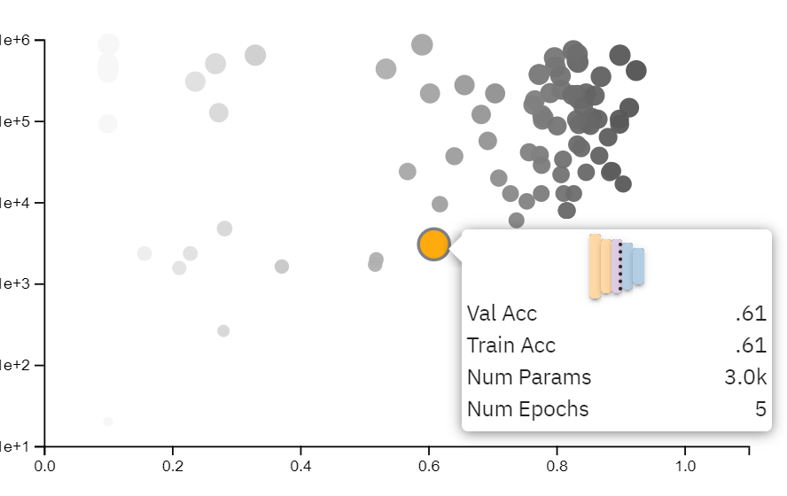
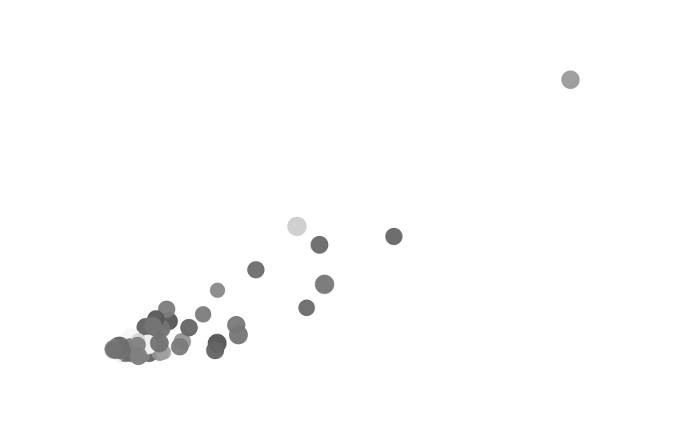
Finding Baseline Architectures
Accuracy vs. # of Parameters
Allows for tradeoff between model performance and model size
MDS Projection based on prediction similarity
Select diffuse models with high accuracy to learn variety in model space
MDS Projection based on structural similarity
See what small changes in structure lead to large changes in accuracy
Uses OTMANN distance between networks(Kandasemy 2018)
Notes:
Spend less time explaining how it works, just why it is useful
Select best performing models with low params
Select diverging models (get one set right, get another set right)
View small differences in architectures =>

Slide 23
T2: Generate local, constrained searches in the neighborhood of baseline models.

Slide 24
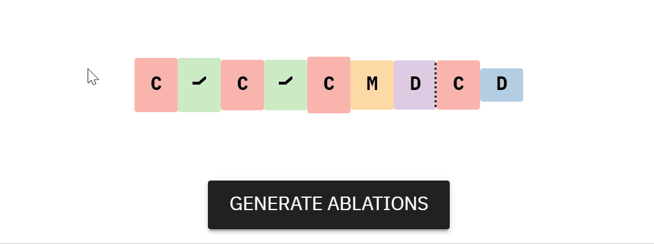
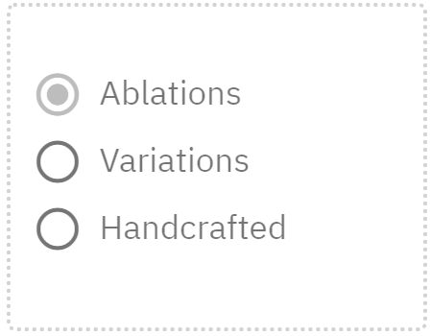
Local Search:
Ablations
Notes:
Single play of gif

Slide 25
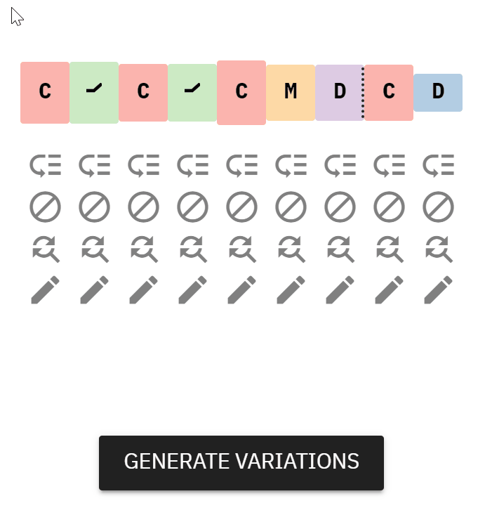
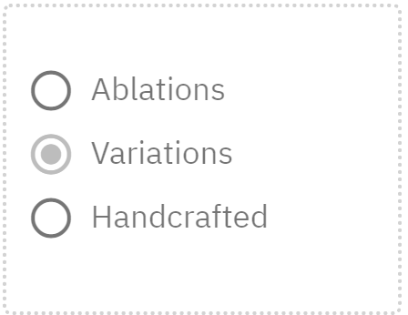
Local Search:
Variations

Slide 26
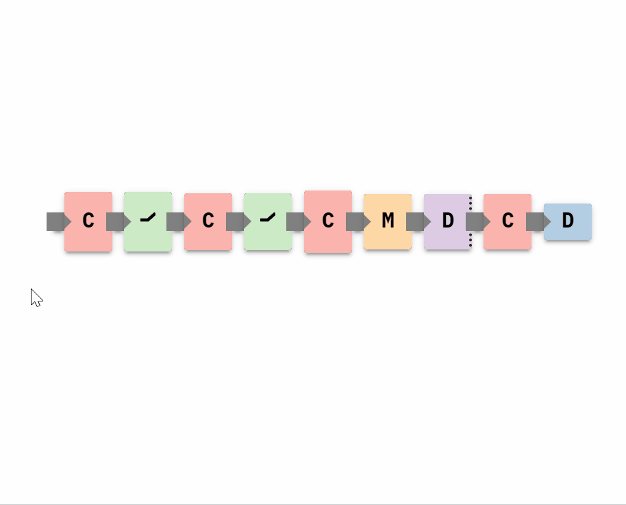
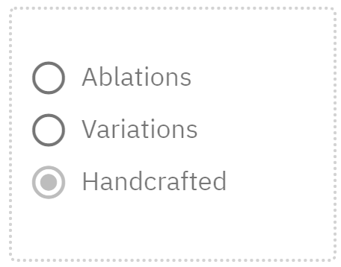
Local Search:
Handcrafting

Slide 27
T3: Visually compare subsets of models to understand small, local differences in architectures.

Slide 28
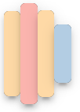
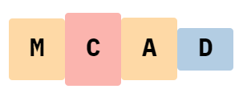
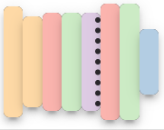
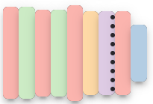
T3: Compare Subsets of Models
Sequential Neural Architecture Chips (SNACs)
Novel visual encoding for neural architectures
Encodes layer type, data width
Prioritizes comparison of layer sequences with minimal screen space

Slide 29
Results
Expert Demo
Use case
Notes:
Add a critical result as well, so it doesn’t sound like marketing
Read out the quotes exactly, don’t reword them

Slide 30
Results – Expert Demos
120 minute study
Model space matched their mental models
Progression of control of the search from coarse to fine, matching Global-to-local parameter space exploration from Sedlmair 2014
“Exploring the models in that space seems like a very appealing thing to do. ...To be able to grab a subselection of them and be able to see at a glance, how do the architectures differ?”
Notes:
Add a critical result as well, so it doesn’t sound like marketing
Read out the quotes exactly, don’t reword them

Slide 31
Results – Expert Demos
120 minute study
Model space matched their mental models
Progression of control of the search from coarse to fine, matching Global-to-local parameter space exploration from Sedlmair 2014
Limit on ceiling of control of process
“I basically don’t want my system to waste time training models that I know will be worse…”
“If you’re at the point where you want to change filters, you should just pull up code”
Notes:
Add a critical result as well, so it doesn’t sound like marketing
Read out the quotes exactly, don’t reword them

Slide 32
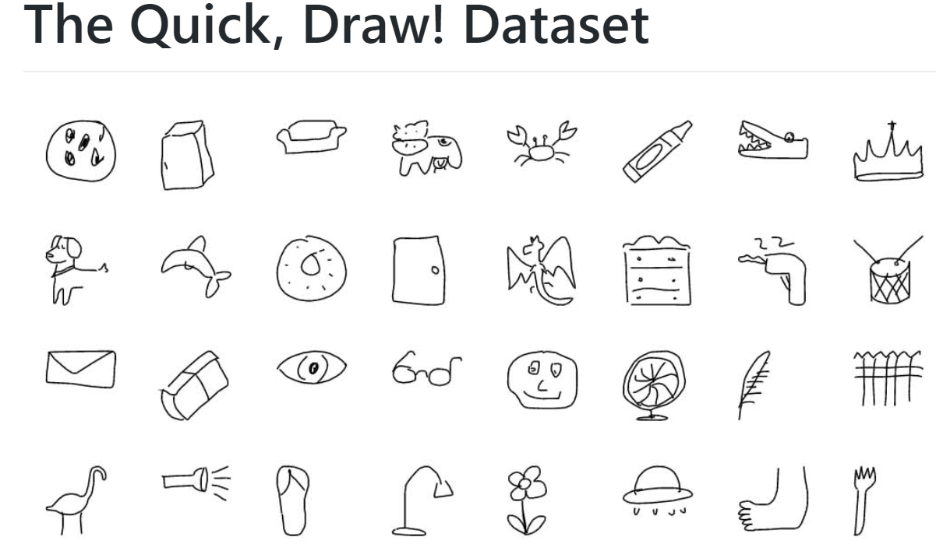
Results – Use Case
Use case building classifier for graffiti example using quickdraw dataset
Before search, best models were
92% accuracy, 412k parameters
90% accuracy, 17k parameters
After search, found model with 91% accuracy and 8.6k parameters
Notes:
Clarify that this wasn’t with the participants (“we” is misleading)

Slide 33
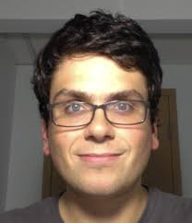
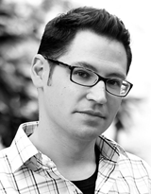
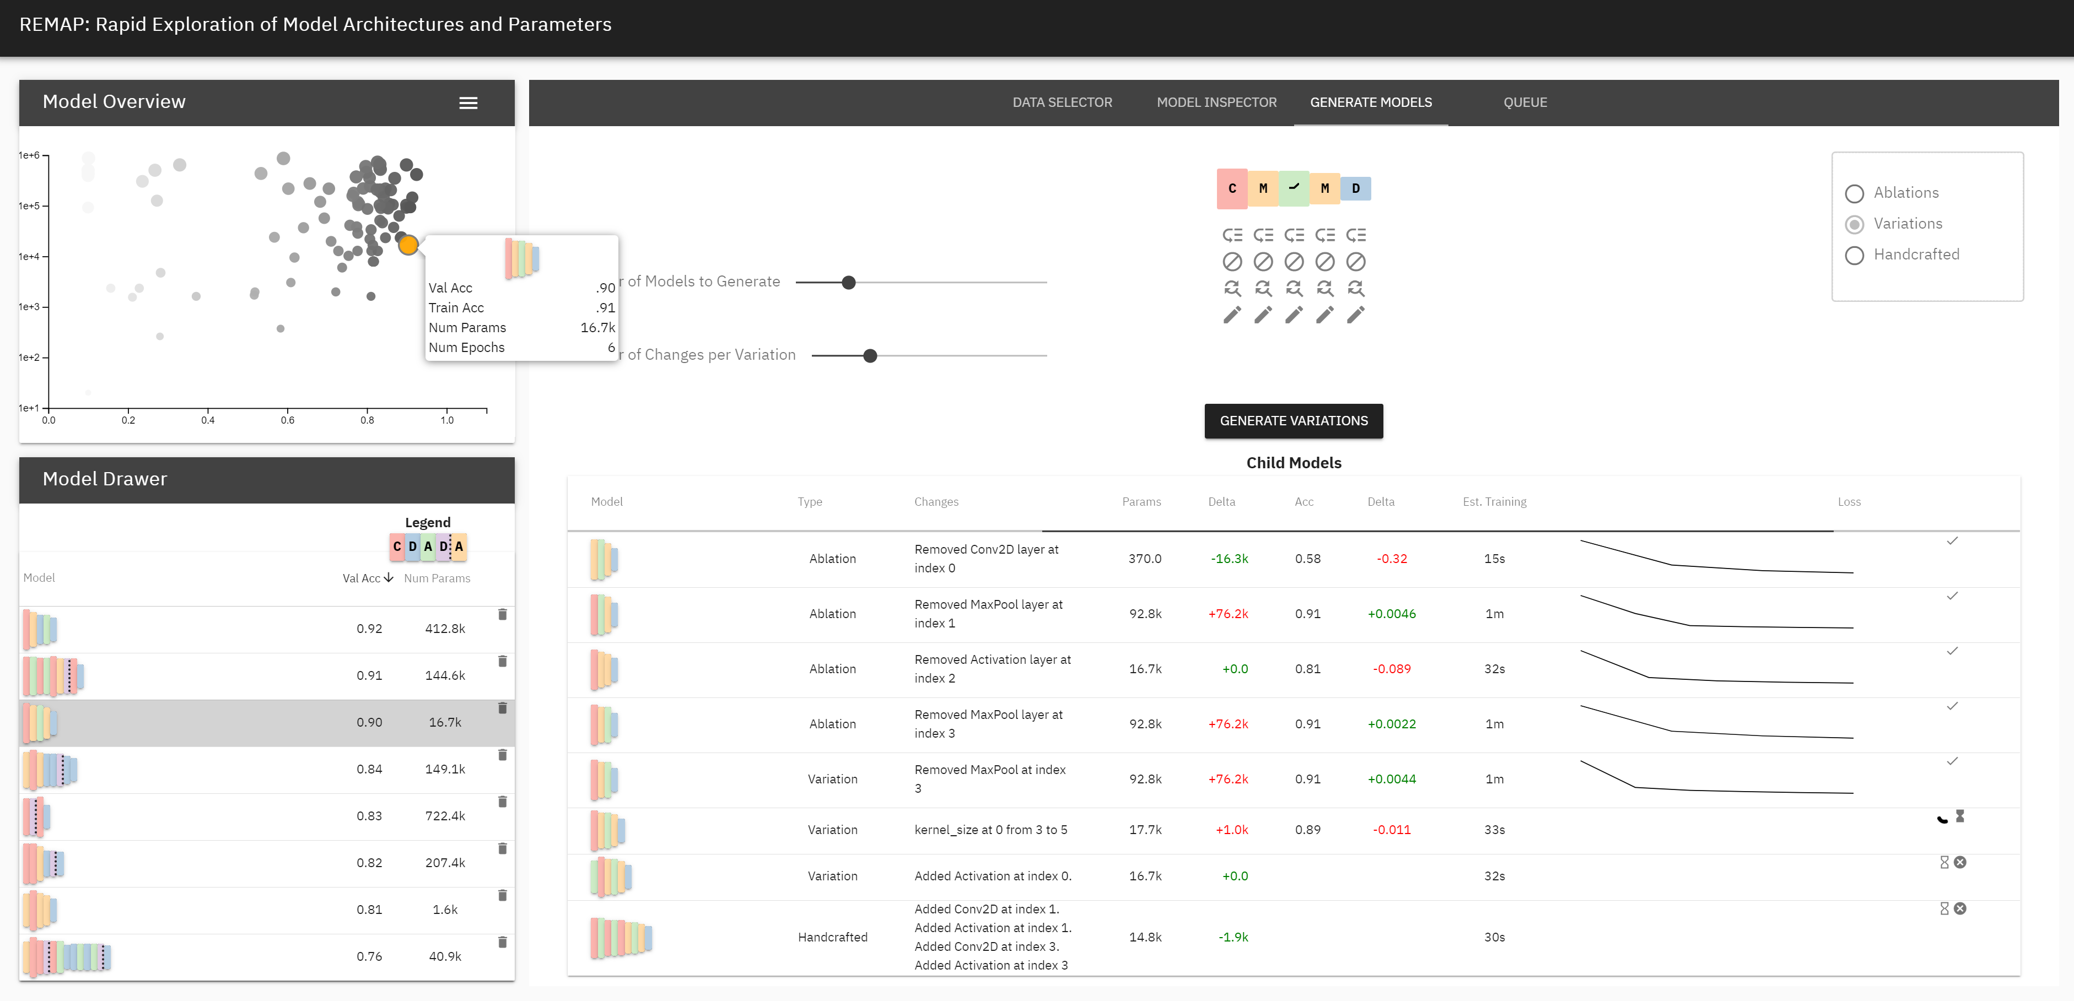
dcashm01@cs.tufts.edu https://github.com/dylancashman/remap_nas
Ablate, Variate, and Contemplate: Visual Analytics for Discovering Neural Architectures
Dylan Cashman
Tufts University
Adam Perer
CMU
Remco Chang
Tufts University
Hendrik Strobelt
MIT IBM Watson AI Lab
REMAP visual analytics tool
Global overview
Semi-auto Local Search
Space-efficient Visual Encoding for NNs
Thanks! Questions?
Notes:
Same contributions as before, separate box
Screenshot is cut off
Fix color
Use conclusion box better
Affiliations logos here

