Slide 1
RNNbow: Visualizing Learning via Backpropagation Gradients in Recurrent Neural Networks
Dylan Cashman¹, Genevieve Patterson², Abigail Mosca¹, Nathan Watts¹, Shannon Robinson¹, Remco Chang¹
¹Tufts University ²Microsoft Research
Notes:
Today I’m going to talk about a tool that we’ve made, call RNNbow, that visualizes gradients during training in order to shed light on the training of an RNN.

Slide 2
RNNbow is a visual analytics tool that illustrates if a recurrent neural network is learning temporal dependencies by inspecting gradients during training.

Slide 3
Talk Overview
Background
Tool Description
Use Cases

Slide 4
Fully Connected Neural Network, CNN
Recurrent Neural Network
y_{i}
y_{i+1}
y_{i+2}
y_{i+3}
h_{i-1}
h_{i}
h_{i+1}
h_{i+2}
h_{i+3}
x_{i}
x_{i+1}
x_{i+2}
x_{i+3}
Notes:
Optional Start
In a fully connected neural network, our goal is to learn weights between all input dimensions. We end up learning a very complicated solution to a classification or regression problem – very flexible, but it has many parameters and requires a lot of data to train. They can be used for general solutions to machine learning problems – Linear regression is a one layer FCNN, SVM is a 2 layer FCNN.
http://www.moonstar.com/~morticia/thesis/chapter2.html
A CNN is trained under the assumption that we don’t need to connect all nodes, just those that are close together. So it’s a more convenient FCNN; more convenient to train, less parameters, but operates under the assumption that locality is meaningful. They are used famously for image classification, but also have applications in _, _, and _.
An RNN takes sequential data as input. Rather then calculating in a single decision, we can think of them as calculating some information from one piece of the input, passing it on to the next input as a sort of context, taking new input, and at each step. It could be trying to tag a youtube video, with each frame a single piece of the input. It has also been used to model language as in Google translate, or predicting patient outcomes given their health record.
In RNNs, we’re learning a few different kinds of weights – we’re learning mappings from the input space into our hidden layer, we’re learning mappings from the hidden layer to the output space, and we’re also learning weights that control how much of the input space gets passed on – how much we remember, how much we ignore.
So, why do we use RNNs? Why are they so magical?

Slide 5
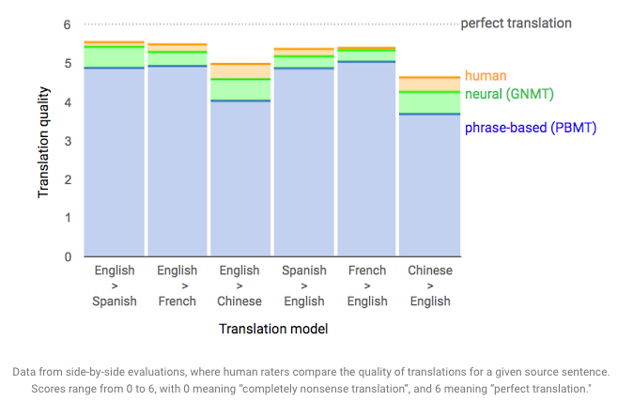
Google Translate with RNN
“A Neural Network for Machine Translation, at Production Scale”, Quoc V. Le & Mike Schuster, 2016-09-27, Google AI Blog.

Slide 6
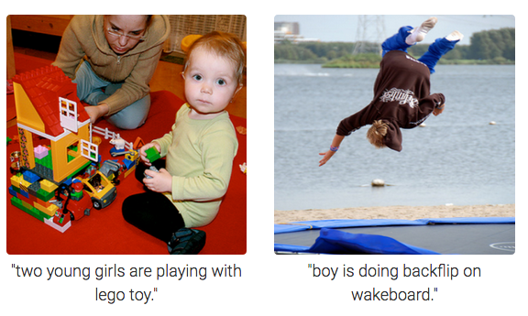
RNNs for Image Captioning
Notes:
They’re also used for image captioning, and tagging youtube videos. But they’re not only confined to text, or images – they’re also used for financial forecasting, or predicting medical outcomes. What do these all have in common? All of are instances of sequential data demanding a model

Slide 7
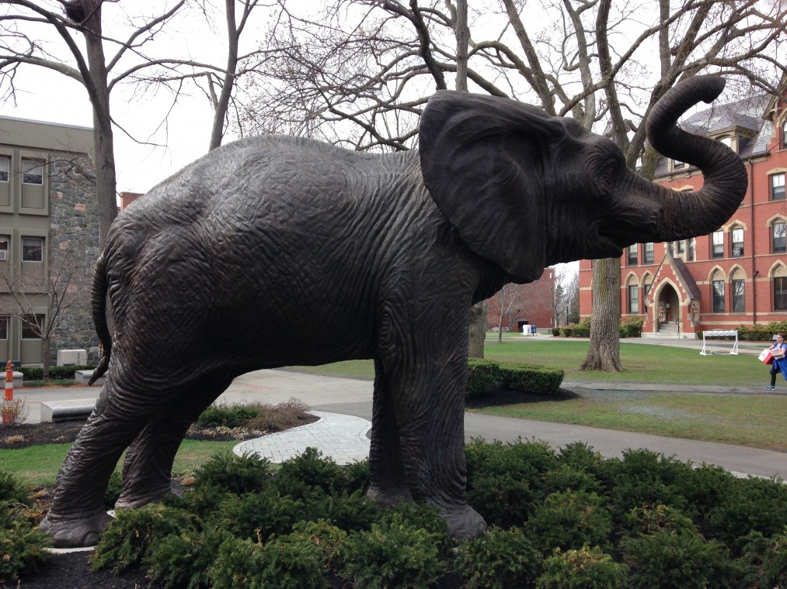
Notes:
All of these instances of sequential data demand memory, learning from context. When we think about artificial intelligence, we ideally want it to learn from context. Now, I want to be precise about what we mean by a memory.

Slide 8
Sequential Language Model
Notes:
Basic language models look at the probability distributions of ngrams in the training set. Generally, the complexity of the algorithm is exponential with the depth of the memory. So what about RNNs?

Slide 9
Sequential Language Model
A sequential model needs to be able to remember context!
Notes:
Basic language models look at the probability distributions of ngrams in the training set. Generally, the complexity of the algorithm is exponential with the depth of the memory. So what about RNNs?

Slide 10
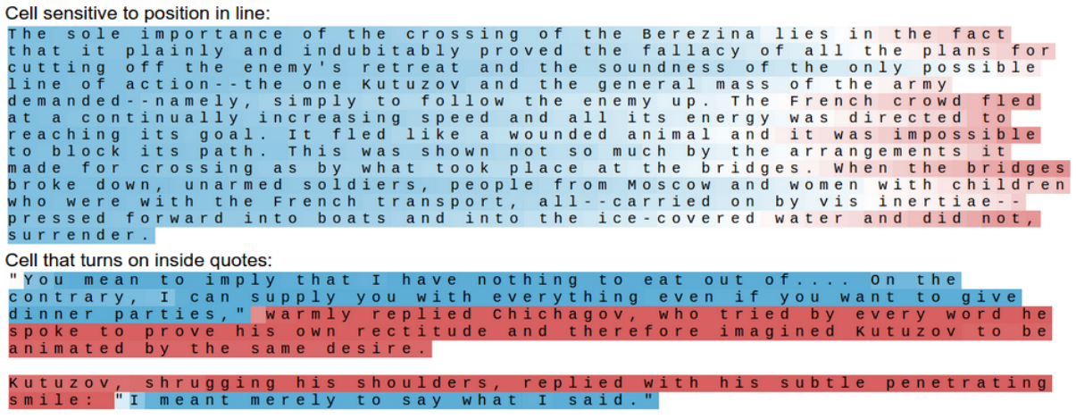
The Unreasonable Effectiveness of RNNs
Andrej Karpathy, http://karpathy.github.io/2015/05/21/rnn-effectiveness/
Notes:
These examples come from an excellent blog post by Andrej Karpathy, who trained an RNN to model language on War and Peace. Then, he visualized the activations of different individual nodes in the RNN, and he found some really startling results. So in that hidden layer, which might be 100 dimensions, one of the dimensions appeared to only activate at the beginning of lines, and would tail off when it believed the line was going to end. The color of each of these characters is calculated before it knows anything past it, so when we see the “b” in bridges, it’s red, but it doesn’t know that the end of the line is coming up. In the second example, one of the dimensions of the hidden layer appears to turn on and turn off depending on if we are inside of a quote. So think of the RNN, chugging through this input, at each step updating its hidden layer. Somehow, it has to remember that it saw a closing quotation 50 characters earlier. This isn’t something you could easily model with a Markov model.
Bring out a title, and make the quotes on a separate table, tell people not to read this. Problem is that if there is colored text, people will try to read it and not pay attention to what is being said.
Point out the quotations

Slide 11
How many neurons per layer did you use? … How many layers? … How long did you train for?
“We did hundreds of experiments, until we knew that we could stop the training after one week. You’re always saying: When do we stop? How do I know I’m done?
… It’s a little bit [of] an art … Some people are better, some worse.”
Mike Schuster, Google Brain

Slide 12
RNNbow
A tool to visualize the gradient during training of a Recurrent Neural Network
Notes:
To address these needs, we built RNNbow (Rainbow), a tool which visualizes gradients from a particular period of training of an RNN. We’ll do a brief demo here.
What is the insight – what is the key thing you would learn from this visualization. What is the punchline. Visualizing the gradient of the hidden state to show both what we’re learning from in the training set and how long term dependencies are being learned.

Slide 13
Key Insight
The gradient dictates how much the network is changing during training
The propagation of the gradient throughout the network is a proxy for how long a memory the network has learned
By visually exploring the evolution of the gradient in the context of training data, a model builder can tell whether their model is learning temporal dependencies and what parts of the training set it learns from the most

Slide 14
Training: Inference
y_{i}
y_{i+1}
y_{i+2}
y_{i+3}
y_{i+4}
y_{i+5}
h_{i}
h_{i+1}
h_{i+2}
h_{i+3}
h_{i+4}
h_{i+5}
h_{i-1}
x_{i-1}
x_{i}
x_{i+1}
x_{i+2}
x_{i+3}
x_{i+4}

Slide 15
Training: Inference
y_{i}
y_{i+1}
y_{i+2}
y_{i+3}
y_{i+4}
y_{i+5}
h_{i}
h_{i+1}
h_{i+2}
h_{i+3}
h_{i+4}
h_{i+5}
h_{i-1}
x_{i-1}
x_{i}
x_{i+1}
x_{i+2}
x_{i+3}
x_{i+4}

Slide 16
Training: Inference
y_{i}
y_{i+1}
y_{i+2}
y_{i+3}
y_{i+4}
y_{i+5}
h_{i}
h_{i+1}
h_{i+2}
h_{i+3}
h_{i+4}
h_{i+5}
h_{i-1}
x_{i-1}
x_{i}
x_{i+1}
x_{i+2}
x_{i+3}
x_{i+4}

Slide 17
Training: Inference
y_{i}
y_{i+1}
y_{i+2}
y_{i+3}
y_{i+4}
y_{i+5}
h_{i}
h_{i+1}
h_{i+2}
h_{i+3}
h_{i+4}
h_{i+5}
h_{i-1}
x_{i-1}
x_{i}
x_{i+1}
x_{i+2}
x_{i+3}
x_{i+4}

Slide 18
Training: Gradient Descent Update
L_{i}
L_{i+1}
L_{i+2}
L_{i+3}
L_{i+4}
L_{i+5}

Slide 19
Training: Gradient Descent Update
L_{i}
L_{i+1}
L_{i+2}
L_{i+3}
L_{i+4}
L_{i+5}

Slide 20
Training: Gradient Descent Update
L_{i}
L_{i+1}
L_{i+2}
L_{i+3}
L_{i+4}
L_{i+5}
For his to know about man, we must have
0

Slide 21
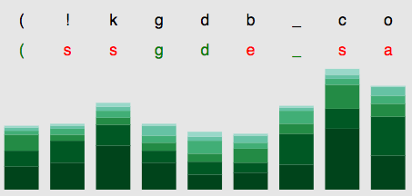
Training: Gradient Descent Update
L_{i}
L_{i+1}
L_{i+2}
L_{i+3}
L_{i+4}
L_{i+5}

Slide 22
Training: Gradient Descent Update
L_{i}
L_{i+1}
L_{i+2}
L_{i+3}
L_{i+4}
L_{i+5}
For his to know about man, we must have
0

Slide 23
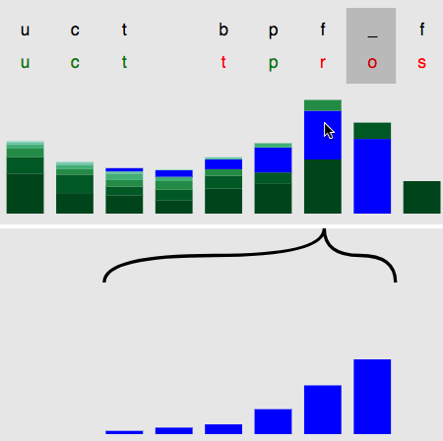
Use Case #1:
Easily identify the vanishing gradient

Slide 24
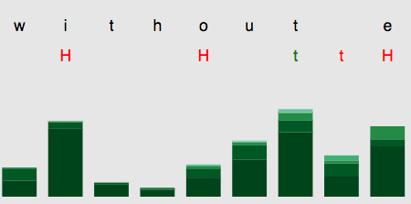
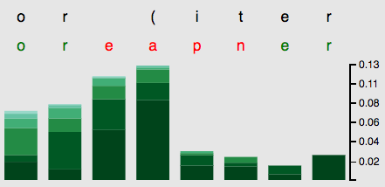
Use Case #2:
Compare training profiles early vs. late in training
Use Case #3:
Identify maximal gradients in training set

Slide 25
RNNbow
A tool to visualize the gradient during training of a Recurrent Neural Network
Notes:
To address these needs, we built RNNbow (Rainbow), a tool which visualizes gradients from a particular period of training of an RNN. We’ll do a brief demo here.
What is the insight – what is the key thing you would learn from this visualization. What is the punchline. Visualizing the gradient of the hidden state to show both what we’re learning from in the training set and how long term dependencies are being learned.

Slide 26
RNNbow: Visualizing Learning via Backpropagation Gradients in Recurrent Neural Networks
Tool for Model Debugging for Recurrent Neural Networks
Visualizes gradient updates in training
Identifies if network is learning long-term dependencies
Tufts University
Microsoft Research
Dylan
Cashman
Abigail
Mosca
Nathan
Watts
Shannon
Robinson
Remco
Chang
Genevieve Patterson

Slide 27
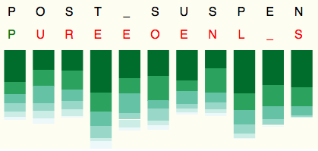

Slide 30
Next Steps
Adjust to industry scale RNNs
Multiple architectures
Multiple Cell types

Slide 31
We want RNNs that learn long term dependencies
Designing a network is hard, so we want feedback on how our design is learning
We don’t want to wait for the network to be fully trained

Slide 32
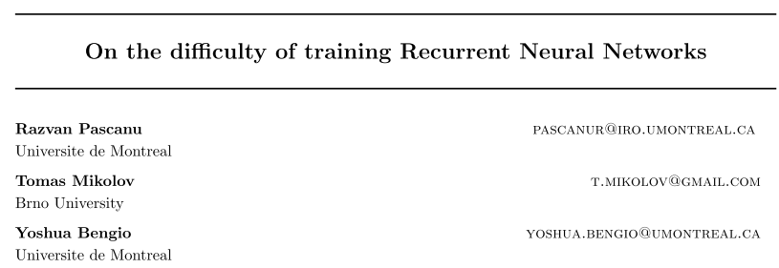
Notes:
However, empirically and theoretically, it’s difficult to train an RNN that is able to learn long term dependencies. There are a lot of hyperparameters to set – what batch size do you use? What about the learning rate, the hidden layer size? Do I have enough data to train all my parameters? There are also architectural choices to be made, do you use an LSTM, a GRU, a stack of layers… On top of that, these things can take a long time to train, and once they are trained, it may be opaque whether it was your choice that was wrong or if it was just a bad fit for the problem.
This is a “trust me” moment in the slides – need to make the audience believe that it’s easy to fail. Say that when it fails, you waste hours and days. Point out model selection. Is there a way to make us debug our training phase.

