Slide 1


A User-based Visual Analytics Workflow for Exploratory Model Analysis
Dylan Cashman*, Shah Rukh Humayoun*, Florian Heimerl**, Kendall Park**, Subhajit Das***, John Thompson***, Bahador Saket***, Abigail Mosca*, John Stasko***, Alex Endert***, Michael Gleicher**, Remco Chang*
* Tufts University, USA
** University of Wisconsin, USA
*** Georgia Tech, USA

Slide 2
What is Exploratory Model Analysis?

Slide 3








Exploratory Data Analysis

Slide 4








Exploratory Data Analysis

Slide 5
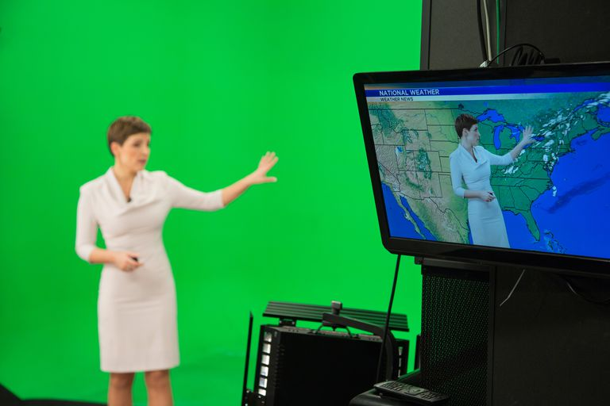
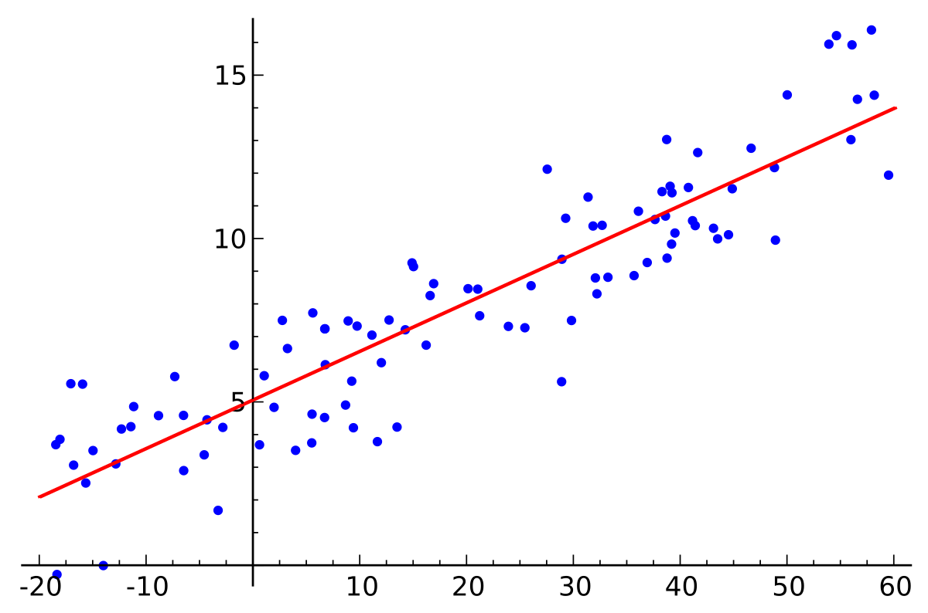
Exploratory Data Analysis
Date | Pressure | Location | Temp
1/5 | 760 | 42E111W | 12.3
2/5 | 805 | 43E111W | 8.4
1/5 | 820 | 41E110W | 9.6
2/5 | 770 | 41E110W | 16.2
1/5 | 900 | 41E112W | 4.5
2/5 | 654 | 41E113W | -1.2
It will rain tomorrow because the air pressure is expected to be 850 mmHg and the temperature will be around 8 degrees.

Slide 6

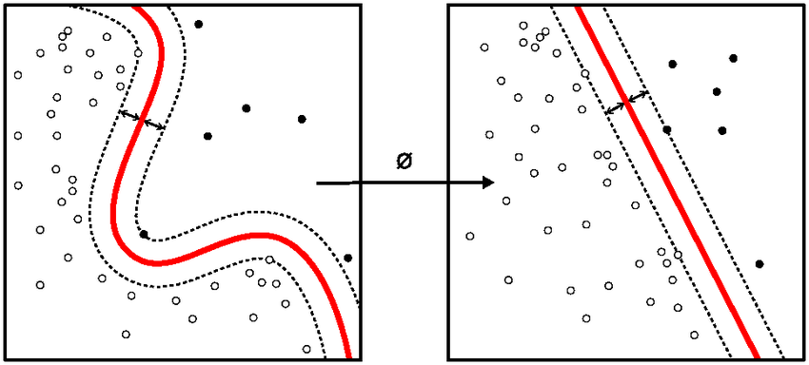
Exploratory Model Analysis
Date | Pressure | Location | Temp
1/5 | 760 | 42E111W | 12.3
2/5 | 805 | 43E111W | 8.4
1/5 | 820 | 41E110W | 9.6
2/5 | 770 | 41E110W | 16.2
1/5 | 900 | 41E112W | 4.5
2/5 | 654 | 41E113W | -1.2
Date | Pressure | Location | Temp
1/5 | 760 | 42E111W | 12.3
2/5 | 805 | 43E111W | 8.4
1/5 | 820 | 41E110W | 9.6
2/5 | 770 | 41E110W | 16.2
1/5 | 900 | 41E112W | 4.5
2/5 | 654 | 41E113W | -1.2
Extract latent information to build a predictive model that can be used on new datasets.

Slide 7

Exploratory Data Analysis
It will rain tomorrow
Fully understand the dataset
Contextualize insights in current state of data
Use relationships in dataset to extrapolate neighborhood information
Exploratory Model Analysis
Build a predictive model
Priority is predictive power on unseen data
Latent, complex relationships within data rather than local information

Slide 8
Exploratory Model Analysis (EMA)
The process of discovering and selecting relevant models that can be used to make predictions on a data source
Both predicted variable and model type* may be initially unknown, may change throughout process
*model types = {classification, regression, community detection, clustering, …}

Slide 9
Research Questions
How do we define EMA?
What is a workflow for Visual Analytics for EMA?
How can we build a system for EMA?
Can a human + machine outperform a machine in EMA?

Slide 10
Outline
Related Work
Process
Visual Analytics System Workflow for EMA
System and Validation
Discussion

Slide 11
Outline
Related Work – Systems and Frameworks
Process
Visual Analytics System Workflow for EMA
System and Validation
Discussion

Slide 12
Related Work: Systems
Categorization inspired by Liu 2017
Model Construction and Steering
  Regression (Muhlbacher 2013, Das 2018)
  Clustering (Nam 2007, Kwon 2018, Sacha 2018, Cavallo 2019)
  Classification (Choo 2010, Kapoor 2010, van den Elzen 2011, Heimerl 2012)
  Dimensionality Reduction (Jeong 2009, Anand 2012, Brown 2012, Choo 2013, Nam 2013, Liu 2015)
Model Explanation
  Regression (Muhlbacher 2013, Das 2018)
  Deep Learning (Liu 2017, Liu 2018, Strobelt 2018, Yosinski 2015, Bilal 2018)
  Classification (Krause 2017, Patel 2010, Ribeiro 2016, Amershi 2015, Ren 2017)
  NLP (Heimerl 2018, Wei 2010)
Model Debugging
  Allsallakh 2014, Cashman 2017, Strobelt 2018, Kumpf 2018
Model Comparison
  Zhang 2018, Muhlbacher 2013, Muhlbacher 2018

Slide 13
Takeaway from Related Work (Systems)
Most VA systems are designed for one type of model, and can make use of properties of that model
  What properties do machine learning models have in common?

Slide 14
Related Work: Workflows/Frameworks
Infovis: Visual mappings and interactions
  Chi & Riedl 1998, Card 1999, van Wijk 2005
Visual Analytics: Modelling for Knowledge Generation
  Keim 2010, Wang 2016, Sacha 2016
Model Externalization:
  Chen & Golan 2016, Andrienko 2019

Slide 15
Takeaway from Related Work (Frameworks)
VA + ML frameworks assume goal of knowledge generation, or a tight integration between user and model
  How can the user select from many types of predictive models?

Slide 16
Outline
Related Work
Process
Visual Analytics System Workflow for EMA
Instantiated System and Validation
Discussion
Takeaways

Slide 17
Our Process
Question ML Experts, Data Scientists
Pilot Study With Users
Derive System Goals

Slide 18
Our Process
What are common properties among many model types that can help exploration?
What input may the user have in the process?
Question ML Experts, Data Scientists
Pilot Study With Users
Derive System Goals
Discussions with ML experts in DARPA Program Data Driven Discovery of Models
Interviews with Client Facing Data Scientists

Slide 19
Our Process
Do users expect different system behavior for different model types?
What is sufficient to explore and select models?
Question ML Experts, Data Scientists
Pilot Study With Users
Derive System Goals
Built simple prototype for EMA
Four participants attempted to choose best model
Collected think-aloud, usability feedback, and qualitative feedback

Slide 20
Our Process
G1: Use data overview to generate problem specifications
G2: Change and adjust specification to get better prediction models
G3: Initially rank the resulting prediction models
G4: Determine the most preferable model beyond initial rankings
G5: Compare model predictions on individual data points in the context of dataset
G6: Transition seamlessly from one step to another in the overall workflow
Question ML Experts, Data Scientists
Pilot Study With Users
Derive System Goals

Slide 21
Our Process
G1: Use data overview to generate problem specifications
G2: Change and adjust specification to get better prediction models
G3: Initially rank the resulting prediction models
G4: Determine the most preferable model beyond initial rankings
G5: Compare model predictions on individual data points in the context of dataset
G6: Transition seamlessly from one step to another in the overall workflow
Question ML Experts, Data Scientists
Pilot Study With Users
Derive System Goals

Slide 22
Outline
Related Work
Process
Visual Analytics System Workflow for EMA
Instantiated System and Validation
Discussion
Takeaways

Slide 23
Workflow for Exploratory Model Analysis (EMA)

Slide 24
Workflow for Exploratory Model Analysis (EMA)

Slide 25

Data and Problem Exploration
2
1
Understanding the data attributes and relationships between these attributes
Understanding what are the possible problem types by exploring system generated problem set
Problem Exploration
Data Exploration

Slide 26
Workflow for Exploratory Model Analysis (EMA)

Slide 27
Model Generation
3
Final problem specification set to
be used for models generation
4
Model Training
Model Generation
Problem Specification
Generation

Slide 28
Workflow for Exploratory Model Analysis (EMA)

Slide 29
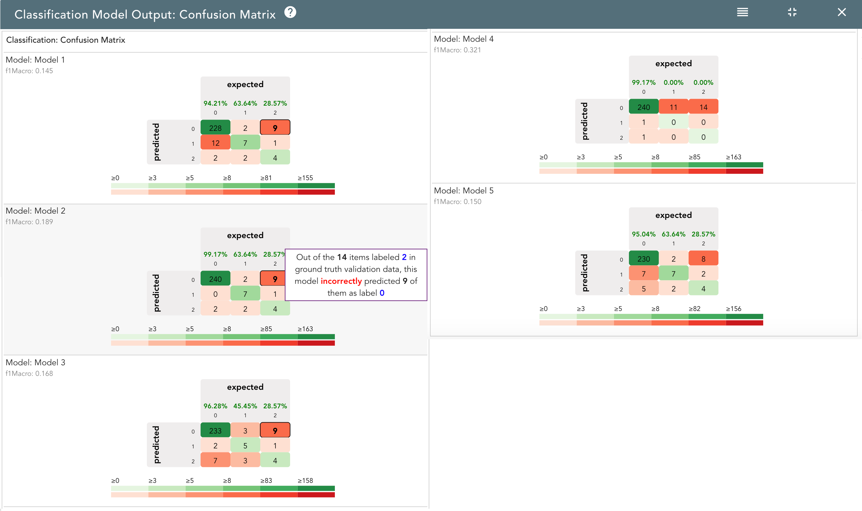
Model Exploration and Selection
5
6
Exploring and comparing prediction models
Preferable models set
Models Exploration
Models Selection

Slide 30
Workflow for Exploratory Model Analysis (EMA)

Slide 31
Outline
Related Work
Process
Visual Analytics System Workflow for EMA
System and Validation
Discussion

Slide 32
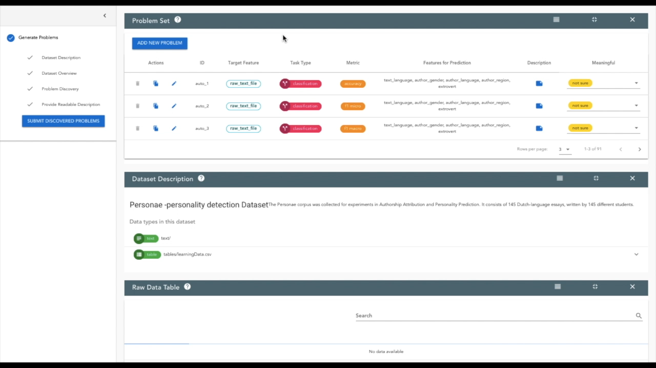

Slide 33
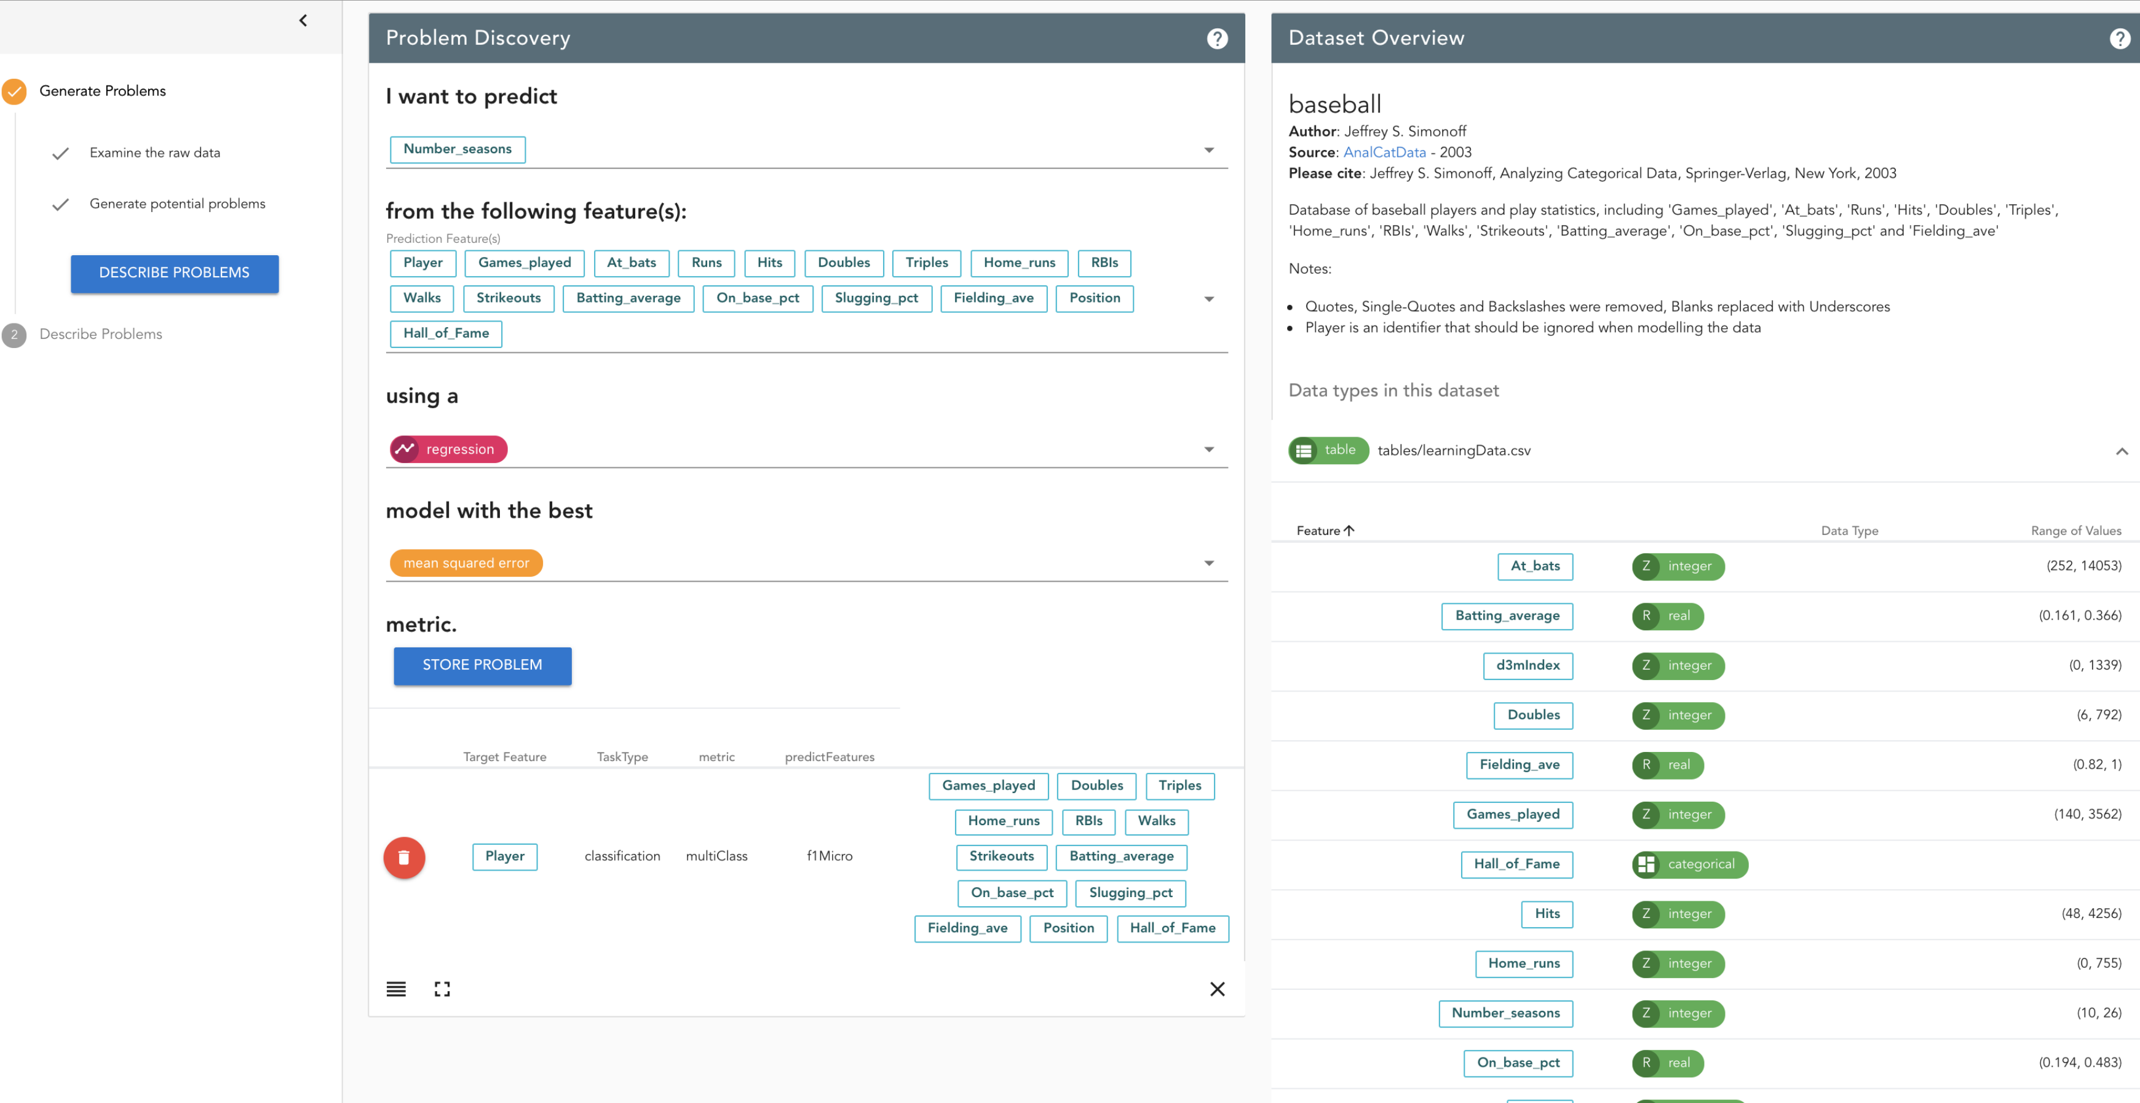

Evaluation
Two rounds of evaluation with 9 domain scientists
24 hour period to generate model on NIST-provided dataset

Slide 34
Results
Compared handcrafted baseline model, model selected by autoML, and model selected by user
autoML > handcrafted model
EMA (human + machine) > autoML (machine only)
Dataset | Problem Type | autoML Score | EMA Score (Ours)
News&Events | Classification | 0.89707928 | 0.90472879
Sensor Data | Regression | 19.8853693 | 9.440946857

Slide 35
Outline
Related Work
Process
Visual Analytics System Workflow for EMA
System and Validation
Discussion

Slide 36
Discussion and Future Work
Investigate effective visual analysis designs for improved model comparison across data and model types
  Comparison of classification models (Ren 2017) has been bettered studied than the comparison of other models (e.g. regression)
Model Steering: how to add model steering that is agnostic to model type
  Model steering has been shown to be very effective, but techniques remain mostly application/model specific

Slide 37
Conclusion
Exploratory Model Analysis (EMA) defined as the process of discovering and selecting relevant models that can be used to make predictions on a data source
We present a Visual Analytics System Workflow for EMA
We develop a system for EMA based on that workflow
Workflow can enable human user to select predictive model better than autoML across multiple model types

Slide 38
A User-based Visual Analytics Workflow for Exploratory Model Analysis
Dylan Cashman*, Shah Rukh Humayoun*, Florian Heimerl**, Kendall Park**, Subhajit Das***, John Thompson***, Bahador Saket***, Abigail Mosca*, John Stasko***, Alex Endert***, Michael Gleicher**, Remco Chang*
* Tufts University, USA
** University of Wisconsin, USA
*** Georgia Tech, USA

Slide 39
Broker
What is the current state of the data?
Analyst
What predictive models can be built from the data?
Exploratory Data Analysis
Exploratory Model Analysis

Slide 40
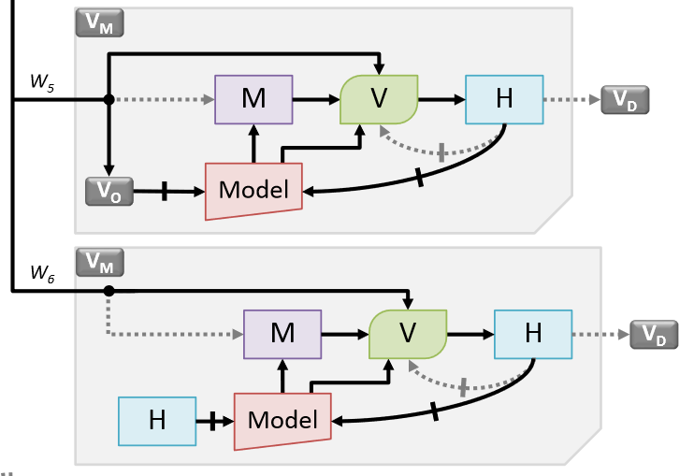
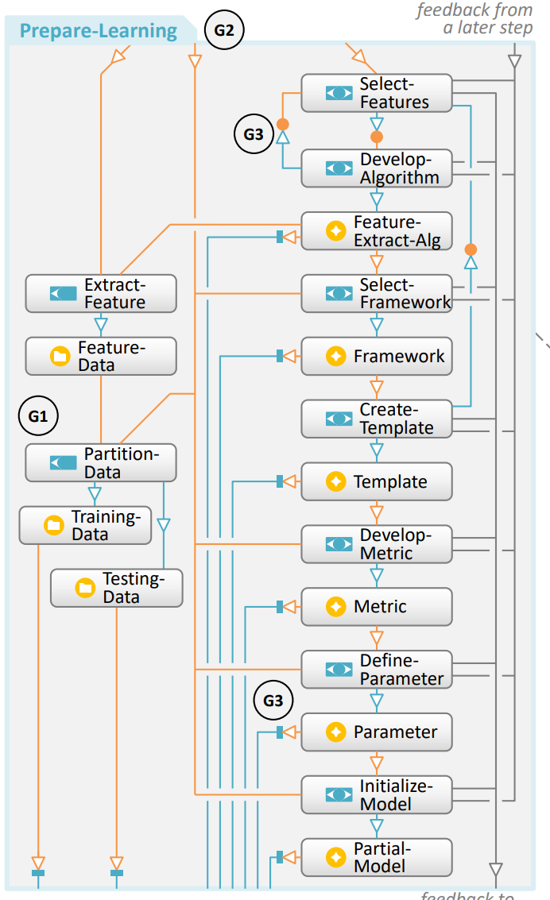
Related Work: Workflows/Frameworks
Chen & Golan TVCG 2016
Sacha, et al. TVCG 2019

Slide 41
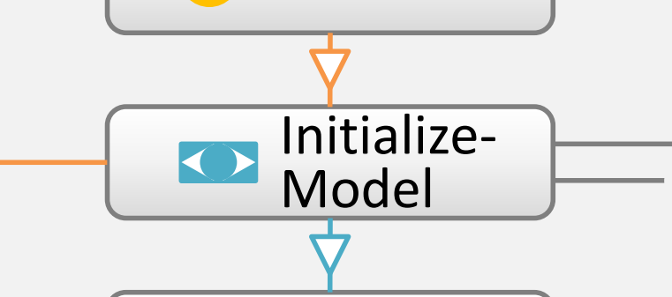
Related Work: Workflows/Frameworks
Chen & Golan TVCG 2016
Sacha, et al. TVCG 2019

Slide 42
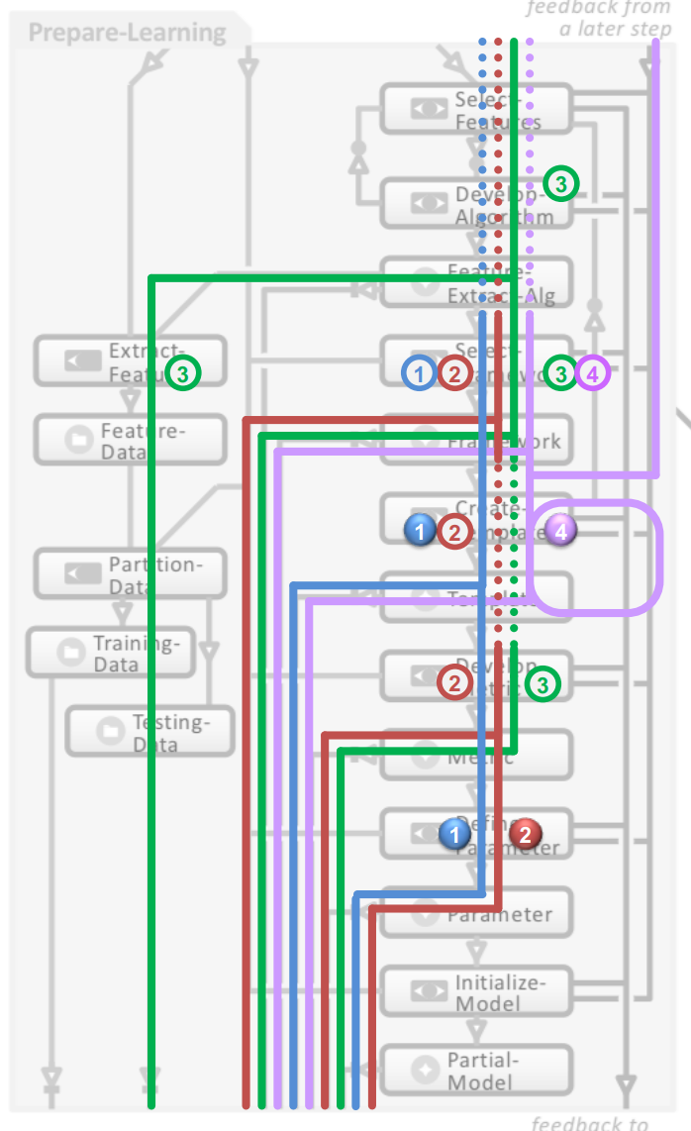
Related Work: Workflows/Frameworks
Chen & Golan TVCG 2016
Sacha, et al. TVCG 2019

Slide 43
Related Work
Examples of building predictive models
  TreePOD
  BEAMES
Related concepts / theories
  Something from Daniel Keim’s group? Sacha?
  Example models (Chen and Golan?)
Two aspects that differ in EMA that make it exploratory
  Don’t know what type of model beforehand, because we don’t know what type of trend we want: periodic, latent, local, global, etc.
  Don’t know which value we want to predict; might want to try out several different queries. (Provide example of two relevant queries on well-known dataset)
Presents new challenge; what is in common between many different modeling problems?

Slide 44
Process
Conversations with ML experts, domain scientists
  Brief description of DARPA project, comparison of autoML vs. human in loop system for building predictive models, is there a value in adding human
Iterative design
  Prototype system with just Classification and Regression to distill design goals
  Presented system, Snowcat
Evaluated with several domain scientists on different kinds of data and problem types
  (Mention this is a formal evaluation by NIST)

Slide 45
Key Aspects of Workflow
Initial data exploration is key to develop queries of what to predict/what features to select

Slide 46
Key Aspects of Workflow
AutoML can be used to generate a diverse set of machine learning models for user to select from

Slide 47
Our Process
G1: Use data overview to generate problem specifications
G2: Change and adjust specification to get better prediction models
G3: Initially rank the resulting prediction models
G4: Determine the most preferable model beyond initial rankings
G5: Compare model predictions on individual data points in the context of dataset
G6: Transition seamlessly from one step to another in the overall workflow
Question ML Experts, Data Scientists
Pilot Study With Users
Derive System Goals

Slide 48
Our Process
G1: Use data overview to generate problem specifications
G2: Change and adjust specification to get better prediction models
G3: Initially rank the resulting prediction models
G4: Determine the most preferable model beyond initial rankings
G5: Compare model predictions on individual data points in the context of dataset
G6: Transition seamlessly from one step to another in the overall workflow
Question ML Experts, Data Scientists
Pilot Study With Users
Derive System Goals

Slide 49
Our Process
G1: Use data overview to generate problem specifications
G2: Change and adjust specification to get better prediction models
G3: Initially rank the resulting prediction models
G4: Determine the most preferable model beyond initial rankings
G5: Compare model predictions on individual data points in the context of dataset
G6: Transition seamlessly from one step to another in the overall workflow
Question ML Experts, Data Scientists
Pilot Study With Users
Derive System Goals

Slide 50
Model Generation
G2: Change and adjust specification to get better prediction models
G3: Initially rank the resulting prediction models
Final problem specification set to
be used for models generation
4
Model Training
Model Generation
Problem Specification
Generation

Slide 51
Key Takeaway
Exploratory Model Analysis differs from other exploratory analyses by the goal of the analysis.
The priority is the quality of the exported model, not an understanding of the dataset.

Slide 52
Research Questions
How do we build a system for EMA?
This is difficult because we don’t know a priori which modeling problem the user wants, or what kind of ML model (SVM, Random Forest, Neural Network) will perform best
Can a human + machine outperform a machine in EMA?
If we don’t care about insight on the dataset, what is the role of the human in the loop?

Slide 53
Our Process
Question ML Experts
  What common features are useful for model selection?
Pilot study to determine common workflow
  How do analysts interact with classification and regression models?
Develop workflow and validate with system

Slide 54
6
5
G3: Initially rank the resulting prediction models
G4: Determine the most preferable model beyond initial rankings
G5: Compare model predictions on individual data points in the context of dataset
Preferable models set
Exploring and comparing prediction models
Models Selection
Models Exploration
Model Exploration and Selection

Slide 55
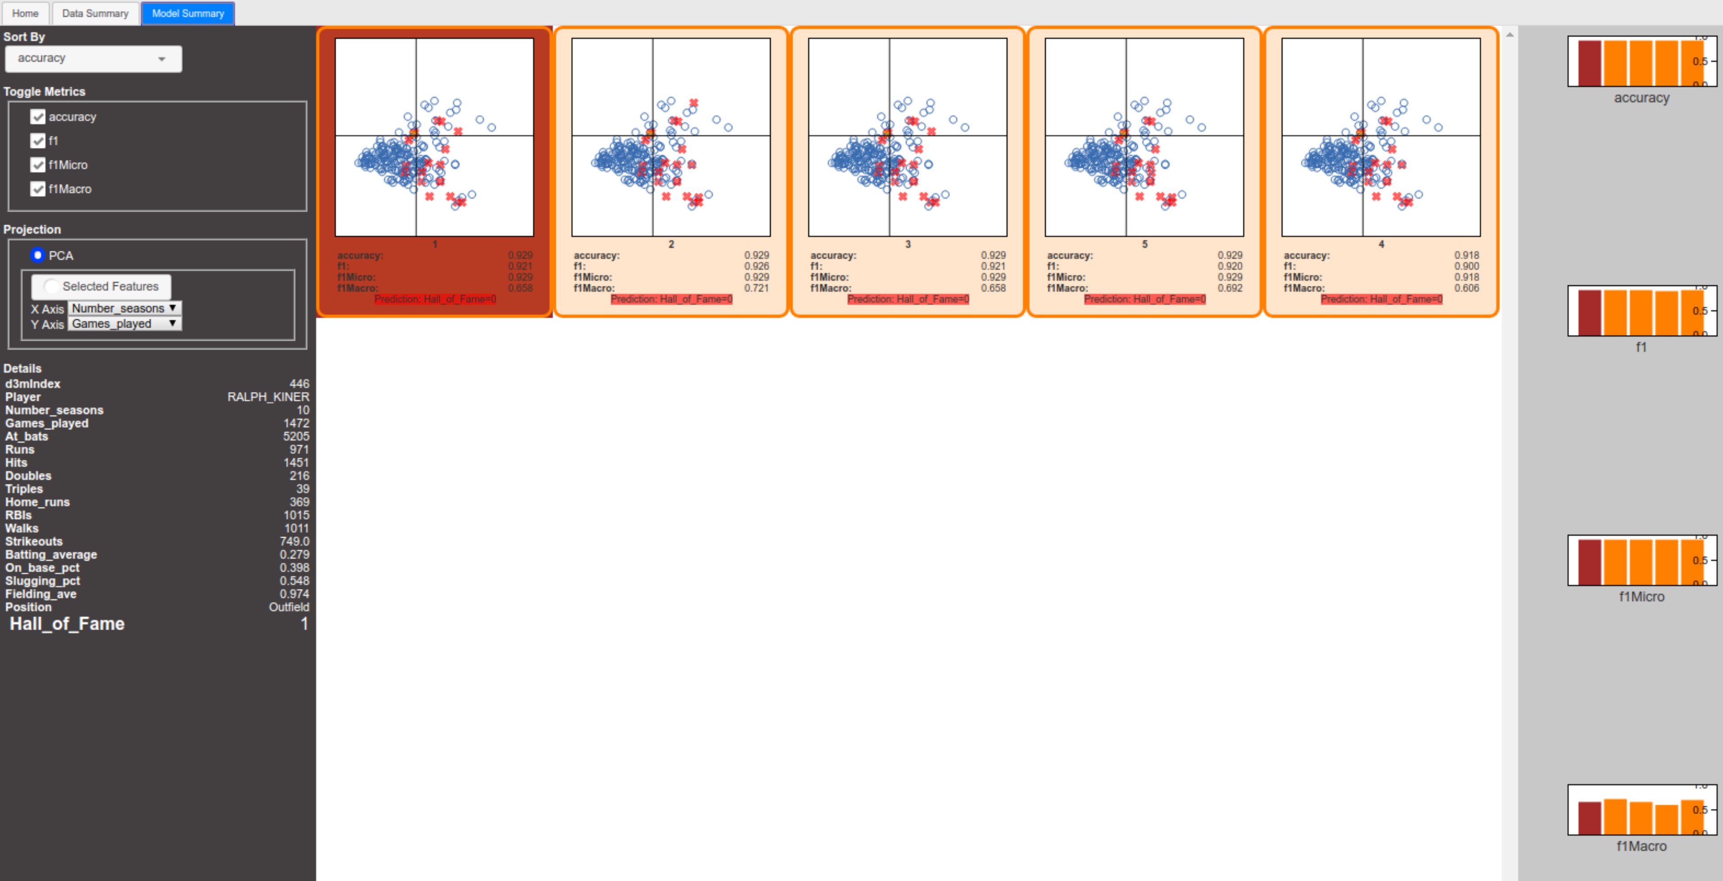
Prototype System

Slide 56
Our Process
G1: Use data overview to generate problem specifications
G2: Change and adjust specification to get better prediction models
G3: Initially rank the resulting prediction models
G4: Determine the most preferable model beyond initial rankings
G5: Compare model predictions on individual data points in the context of dataset
G6: Transition seamlessly from one step to another in the overall workflow
Question ML Experts, Data Scientists
Pilot Study With Users
Derive System Goals

Slide 57
Our Process
G1: Use data overview to generate problem specifications
G2: Change and adjust specification to get better prediction models
G3: Initially rank the resulting prediction models
G4: Determine the most preferable model beyond initial rankings
G5: Compare model predictions on individual data points in the context of dataset
G6: Transition seamlessly from one step to another in the overall workflow
Question ML Experts, Data Scientists
Pilot Study With Users
Derive System Goals

Slide 58
Data and Problem Exploration
G1: Use data overview to generate problem specifications
G2: Change and adjust specification to get better prediction models
Data attributes and their relationships
The possible problem types generated by the system
Problem Exploration
Data Exploration

Slide 59
Related Work: Workflows/Frameworks
Infovis: Visual mappings and interactions
  Chi & Riedl 1998, Card 1999, van Wijk 2005
Visual Analytics: Modelling for Knowledge Generation
  Keim 2010, Wang 2016, Sacha 2016
Model Externalization
  Chen & Golan 2016, Andrienko 2019

Slide 60
Related Work: Workflows/Frameworks
Infovis: Visual mappings and interactions
  Chi & Riedl 1998, Card 1999, van Wijk 2005
Visual Analytics: Modelling for Knowledge Generation
  Keim 2010, Wang 2016, Sacha 2016
Model Externalization
  Chen & Golan 2016, Andrienko 2019

Slide 61
Related Work: Systems
Categorization inspired by Liu 2017
Model Construction and Steering
Model Explanation
Model Debugging
Model Comparison

Slide 62
Related Work: Systems
Categorization inspired by Liu 2017
Model Construction and Steering
  Regression (Muhlbacher 2013, Das 2018)
  Clustering (Nam 2007, Kwon 2018, Sacha 2018, Cavallo 2019)
  Classification (Choo 2010, Kapoor 2010, van den Elzen 2011, Heimerl 2012)
  Dimensionality Reduction (Jeong 2009, Anand 2012, Brown 2012, Choo 2013, Nam 2013, Liu 2015)
Model Explanation
Model Debugging
Model Comparison
New models can be discovered and explored, but systems allow only one type of model – limits exploration

Slide 63
Related Work: Systems
Categorization inspired by Liu 2017
Model Construction and Steering
Model Explanation
  Regression (Muhlbacher 2013, Das 2018)
  Deep Learning (Liu 2017, Liu 2018, Strobelt 2018, Yosinski 2015, Bilal 2018)
  Classification (Krause 2017, Patel 2010, Ribeiro 2016, Amershi 2015, Ren 2017)
  NLP (Heimerl 2018, Wei 2010)
Model Debugging
Model Comparison
Explanation is important for model trust and selection, but does not allow for discovery

Slide 64
Related Work: Systems
Categorization inspired by Liu 2017
Model Construction and Steering
Model Explanation
Model Debugging
  Allsallakh 2014, Cashman 2017, Strobelt 2018, Kumpf 2018
Model Comparison
Debugging is important for model trust and selection, but does not allow for discovery

Slide 65
Related Work: Systems
Categorization inspired by Liu 2017
Model Construction and Steering
Model Explanation
Model Debugging
Model Comparison
  Zhang 2018, Muhlbacher 2013, Muhlbacher 2018
Comparison is integral to model selection and exploration, but systems only allow one type of model

Slide 66
Key Aspects of Workflow
Simple visualizations of model outputs can be invaluable

