Slide 1
Lecture 06: Visual Analytics for Machine Learning
COMP 150-04: Visual Analytics
October 8, 2019

Slide 2
Outline
Visual Analytics and why we need ML
High-level overview of ML
Why should visualization help?
Five ways VA makes ML more accessible
Notes:
Today, we’re going to do a quick overview of ML and what makes it hard to use. Then, we’ll talk about why visualization might help with these issues.
We’ll finish by looking at 5 ways Visual Analytics has been used to make ML more accessible.

Slide 3
Review: What is VA and why do we need it?
Wicked Problems
Data is large (rows/columns) and complex (many relationships and latent variables)

Slide 4
Example 1: “How the Swedes Book their Summer Vacations”
Tripadvisor (circa 2015)
“Tell me if there’s anything interesting about the way the Swedes book their summer vacations”
Notes:
Network security team – is there a “bad actor” in a network or a node that’s been hacked (insider threat scenario – what is the norm? – to many false positives)
Kensho – fin tech

Slide 5
Example 2: “Financial (Wire) Fraud”
Bank of America (circa 2007)
Legal responsibility for banks to report suspicious financial transactions (money laundering, supporting terrorist organizations, etc)

Slide 6
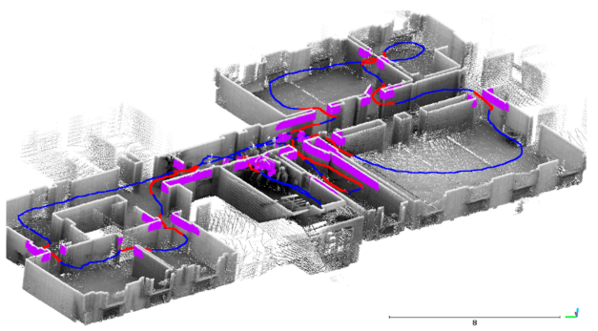
Example 3: “Disease Spread within a Hospital”
Mass General Hospital (MGH), (circa 2019)
“Do we have a problem of disease spreading within the hospital? If so, how?”

Slide 7
Review: What is VA and why do we need it?
Wicked Problems
Data is large (rows/columns) and complex (many relationships and latent variables)
We have tools for this:
Static visualizations
Statistics and verifiable experiments
Domain Expertise
Visual Analytics is the integration of these tools into a solution for the wicked problem
Notes:
We have tools for this. We have nice static visualizations, we have statistics that let us test hypotheses and model the data using linear regression or logistic regression. And we have domain experts who understand the data.
By developing an integrated environment, each of these three tools are strengthened: The visualizations are augmented with additional statistical knowledge, the statistics are given context in the data, and the domain expert is able to leverage the visualizations and statistics along with domain logic, to synthesize conclusions.
And then we can answer all our wicked problems and we have a big party to celebrate.
But this really doesn’t reflect the modern environment of data science, because basic statistics often aren’t sufficient to analyze unstructured data.

Slide 8
Basic Statistics and Unstructured Data
What statistical test or model would help you determine the following?
Is this a spam email?
Is this a real review, or a review by a bot?
Subj: A++ MAKE MONEY FROM HOME 1000/WK
I enjoyed stay at this hotel it was the best good service
Notes:
It turns out that regular statistics have trouble with unstructured data. Let’s look at text as an example.
First, consider the classic problem of a spam filter. What would be a hypothesis that you could test to figure out if this is spam? (ask audience, look for, “existence of a word, all caps, etc.”)
Ok, but how about this problem – determining if this is a real review? (ask audience). There’s more nuance in the data – is this abnormal grammar for this user? Is there other data that might help (IP address, time of day, etc).

Slide 9
Image Classification
If the input data is a bitmap, what model would know this was a cat?

Slide 10
How do we define Machine Learning?
Machine Learning (ML) is a type of statistics that excels at learning from unstructured and complex data.
Traditional statistics fits the data to a simple model, like a normal distribution. There is a closed-form solution to fit the model (Least Squares)
ML fits the data to a complex model that typically doesn’t have a closed-form solution. It finds a good fit to the model by iteratively finding better solutions.
Notes:
Here, we’ll define Machine Learning, at least for the purpose of this course.
Machine learning is a type of statistics that excels at learning from unstructured and complex data.
Another way to look at it: traditional statistics like we looked at the last few weeks fit the data to a simple model, like a normal distribution. There’s a closed-form solution to fit the model.

Slide 11
Machine Learning and Big Data
Notes:
Machine learning has exploded in popularity the last few years; a lot of people ask the question, why now? It’s an old field, from the 60s, at least. On answer is computational – computers have become powerful enough, we now do computations on GPUs. But another factor is that the amount of unstructured data that we record now is increasing exponentially.
This is a graphic from google trends, showing search interest over the last 15 years. You can see that the interest for big data, in green, jumped up around 2010, and then soon after, machine learning rose up to meet it. Along with deep learning, which is one type of machine learning. In red, at the bottom, we have visual analytics. This is not to show that people don’t use visualizations, but it illustrates two things – just how much in the zeitgeist ML is, and also the fact that VA is not an established term, yet, outside of research.

Slide 12
Outline
Visual Analytics and why we need ML
High-level overview of ML
Why should visualization help?
Five ways VA makes ML more accessible
Notes:
Today, we’re going to do a quick overview of ML and what makes it hard to use. Then, we’ll talk about why visualization might help with these issues.
We’ll finish by looking at 5 ways Visual Analytics has been used to make ML more accessible.

Slide 13
Raindrops Keep Falling on My Head
Temp | Pressure | Wind | Rained | Played Tennis?
58 | .851 | 5mph | no | Yes
64 | .852 | 15mph | no | No
71 | 1.054 | 12mph | yes | No
58 | .901 | 0mph | overcast | Yes
74 | 1.110 | 0mph | no | ?
How can we predict if I will play tennis today??

Slide 14
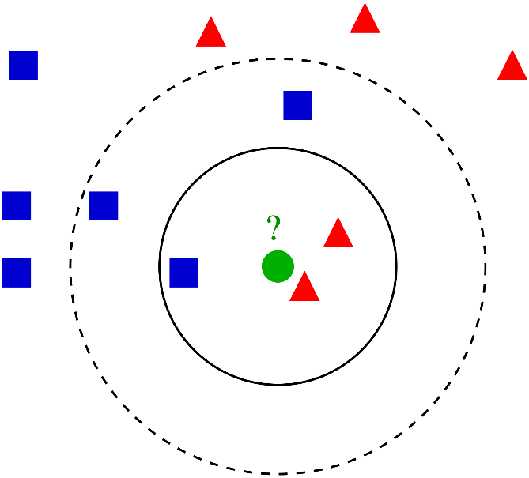
ML Method #1: k Nearest Neighbors (kNN)
Assumption: Similar data should be labeled similarly
For each new data point, look at its k nearest neighbors. Predict the most frequent label

Slide 15
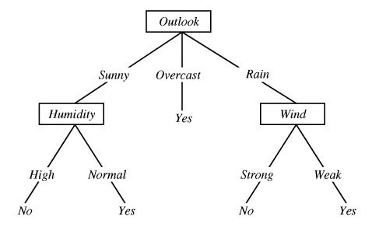
ML Method #2: Decision Tree
Assumption: Breakpoints in each feature can divide the possible labels
Scan the training data, and slowly build rules that divide the labeled data most-efficiently.

Slide 16
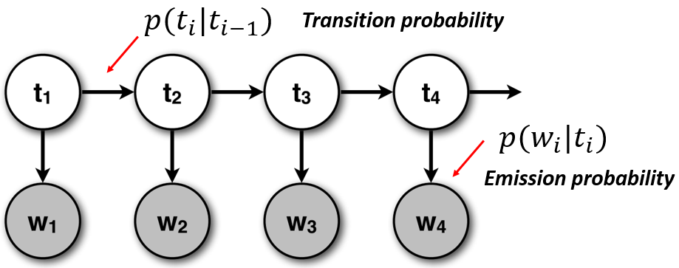
ML Method #3: Hidden Markov Model
Assumption: There is some latent, unobserved temporal state that influences whether I play (watched tennis on TV)
Scan the training data, and slowly infer when you’re in that state, and how behavior changes in state

Slide 17
Machine Learning Types
When labeled data is available, ML can be used to make predictions
Classification – labels are nominal
Regression – labels are numerical
When labeled data is not available, ML can be used to find latent structure
Clustering
Dimensionality Reduction/Topic Modeling
In general, ML fits a function to data by iteratively solving an optimization problem over a training set

Slide 18
But ML Doesn’t Always Work…
ML can be really difficult to use/program for.
Different languages
Low-level bindings
Poor documentation and constantly evolving open source code

Slide 19
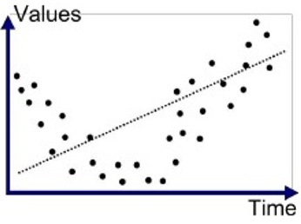
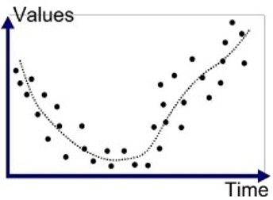
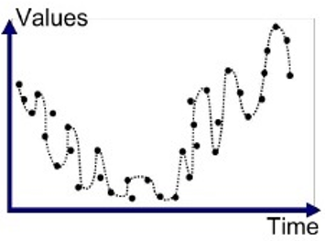
But ML Doesn’t Always Work…
It requires a lot of ML knowledge to use algorithms correctly
Example: Overfitting

Slide 20
But ML Doesn’t Always Work…
Model Selection: How do you know which model to use? What about the parameters?
Source: https://scikit-learn.org

Slide 21
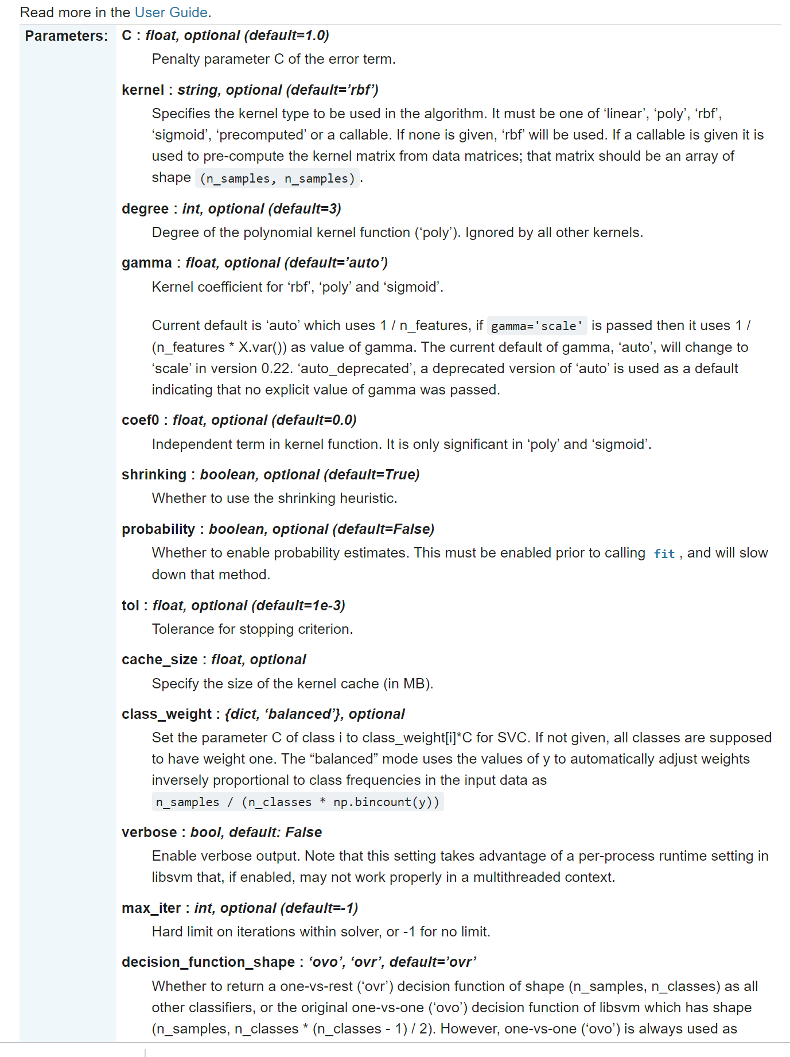
But ML Doesn’t Always Work…
Source: https://scikit-learn.org

Slide 22
Wicked Problems of ML
Implementation/Complexity
Buggy code, requires high level of expertise
Data Quality
Missing data, noisy data
Model Selection
Model mismatch
Difficult to Interpret/Explain
Are models actionable?

Slide 23
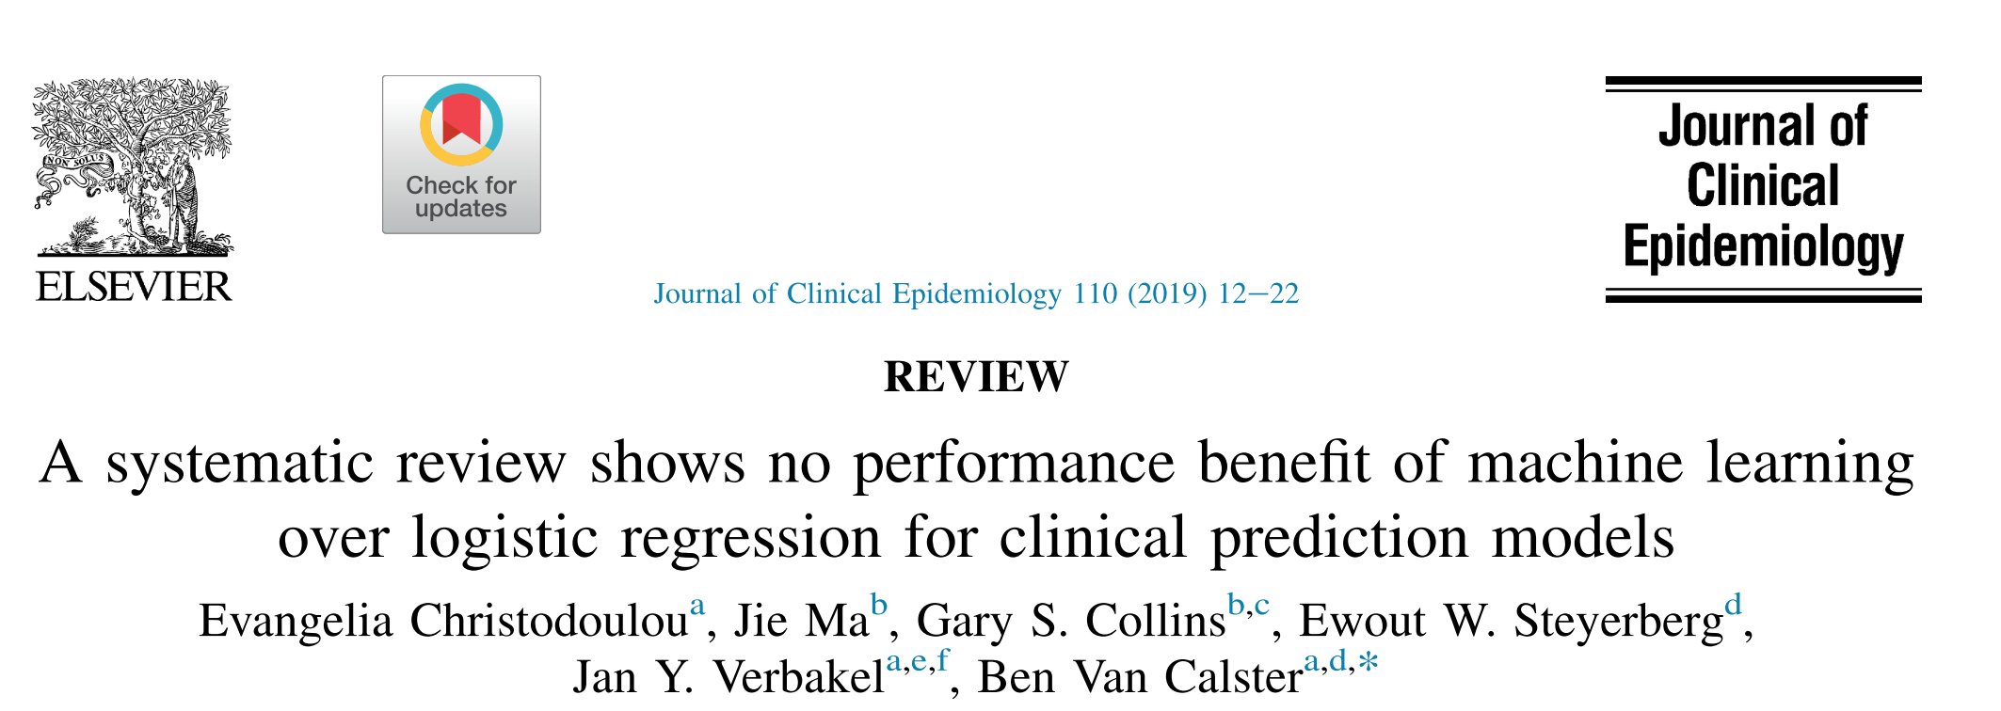
The Result…

Slide 24
Claim
Visualization can offer (imperfect) solutions to the “wicked” problems in machine learning.
Why Visualization?

Slide 25
Outline
Visual Analytics and why we need ML
High-level overview of ML
Why should visualization help?
Visualization as affordance
Five ways VA makes ML more accessible
Notes:
Today, we’re going to do a quick overview of ML and what makes it hard to use. Then, we’ll talk about why visualization might help with these issues.
We’ll finish by looking at 5 ways Visual Analytics has been used to make ML more accessible.

Slide 26
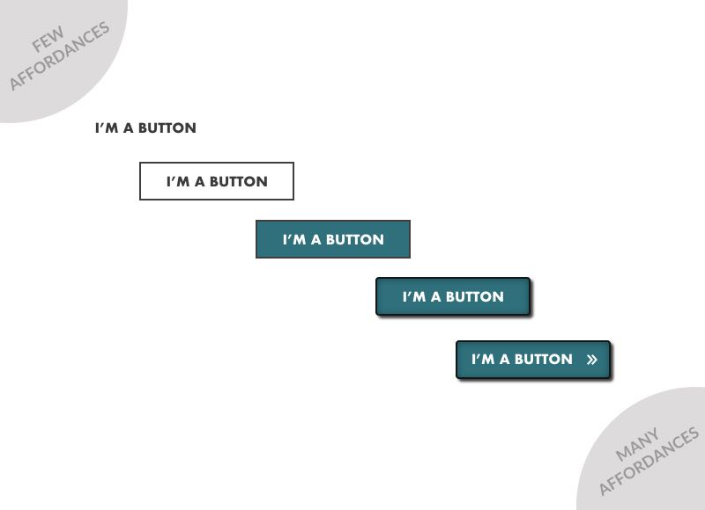
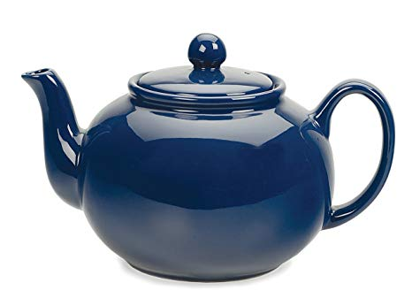
Affordances
From Human Factors/Engineering
Features of an object that afford or imply how to use them

Slide 28
Imagine if in order to use a car…

Slide 29
Imagine if in order to use a car…
You had to understand the combustion engine, aerodynamics, computerized traction control, materials engineering, robotics, manufacturing…

Slide 30
Imagine if in order to use a car
You had to understand the combustion engine, aerodynamics, computerized traction control, materials engineering, robotics, manufacturing…
Instead, most users can control a car only understanding abstractions
Gas pedal, brake pedal, steering wheel

Slide 31
Model Abstractions
Models and Data have abstract qualities and interactions too!
“Good” model vs. “Bad” model
Get me more models/data like this one (Similarity)
What parts of my data does my model perform well on?

Slide 32
Visual Encodings == Model With Affordances
We use static affordances in software all the time
A visual encoding is a representation of data using visual channels
By visually encoding a model, we can produce a representation with affordances

Slide 33
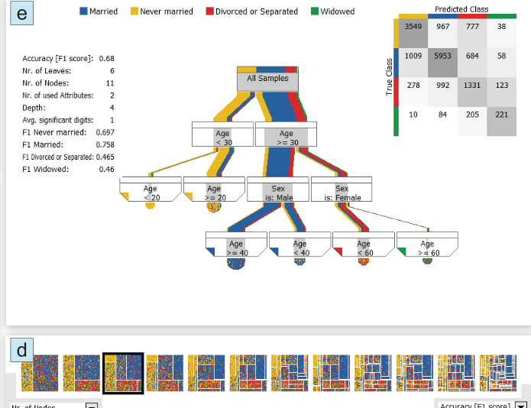
Decision Trees
Muhlbacher et al 2018

Slide 34
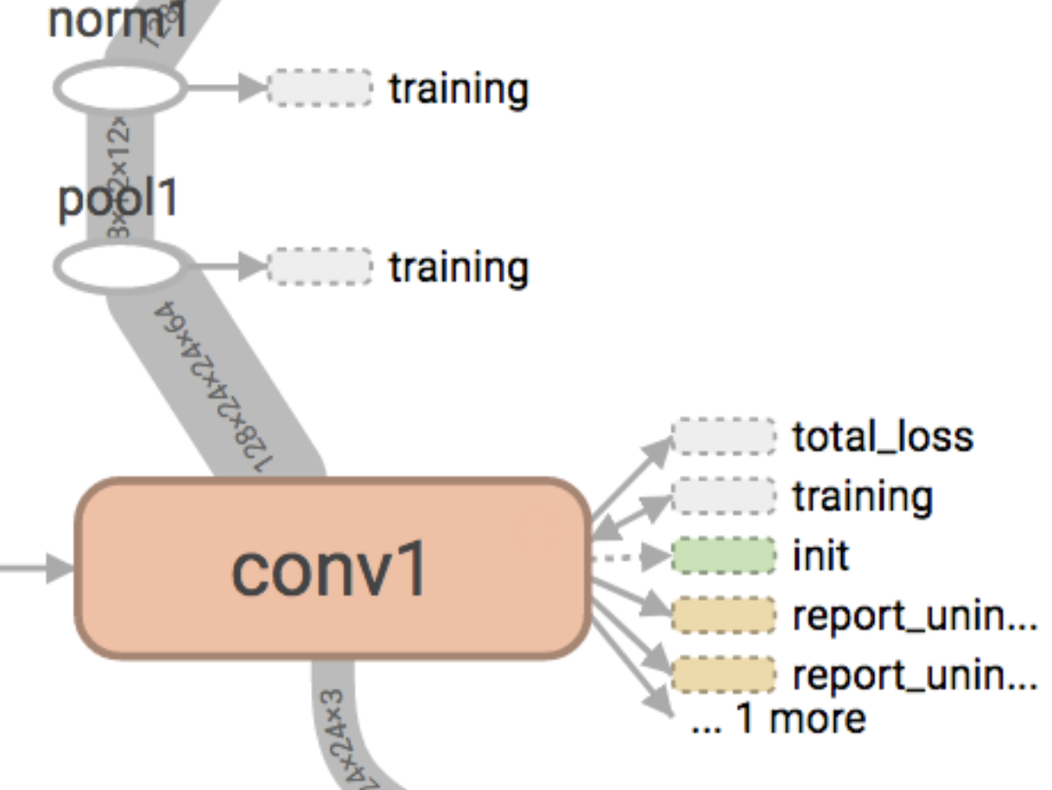
Tensor-level Computation Graph
Wongsuphasawat et al 2018

Slide 35
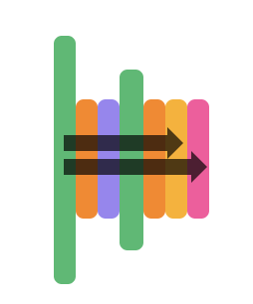
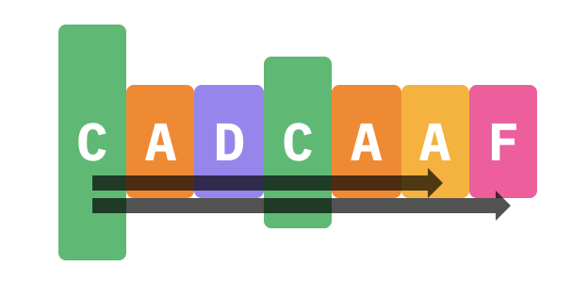
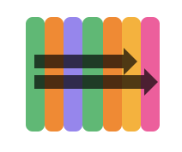
Visualizing Skip Connections in Neural Networks

Slide 36
Semantic Interactions
Endert 2014

Slide 37
Outline
Visual Analytics and why we need ML
High-level overview of ML
Why should visualization help?
Five ways VA makes ML more accessible (and flashy examples)
Notes:
Today, we’re going to do a quick overview of ML and what makes it hard to use. Then, we’ll talk about why visualization might help with these issues.
We’ll finish by looking at 5 ways Visual Analytics has been used to make ML more accessible.

Slide 38
Wicked Problems of ML
Implementation/Complexity
Model Construction
Data Quality
Model Selection
Difficult to Interpret/Explain

Slide 39
Example #1: Model Construction
Cashman et al 2019
https://vimeo.com/360155168

Slide 40
Wicked Problems of ML
Implementation/Complexity
Model Construction
Model Debugging
Data Quality
Model Selection
Difficult to Interpret/Explain

Slide 41
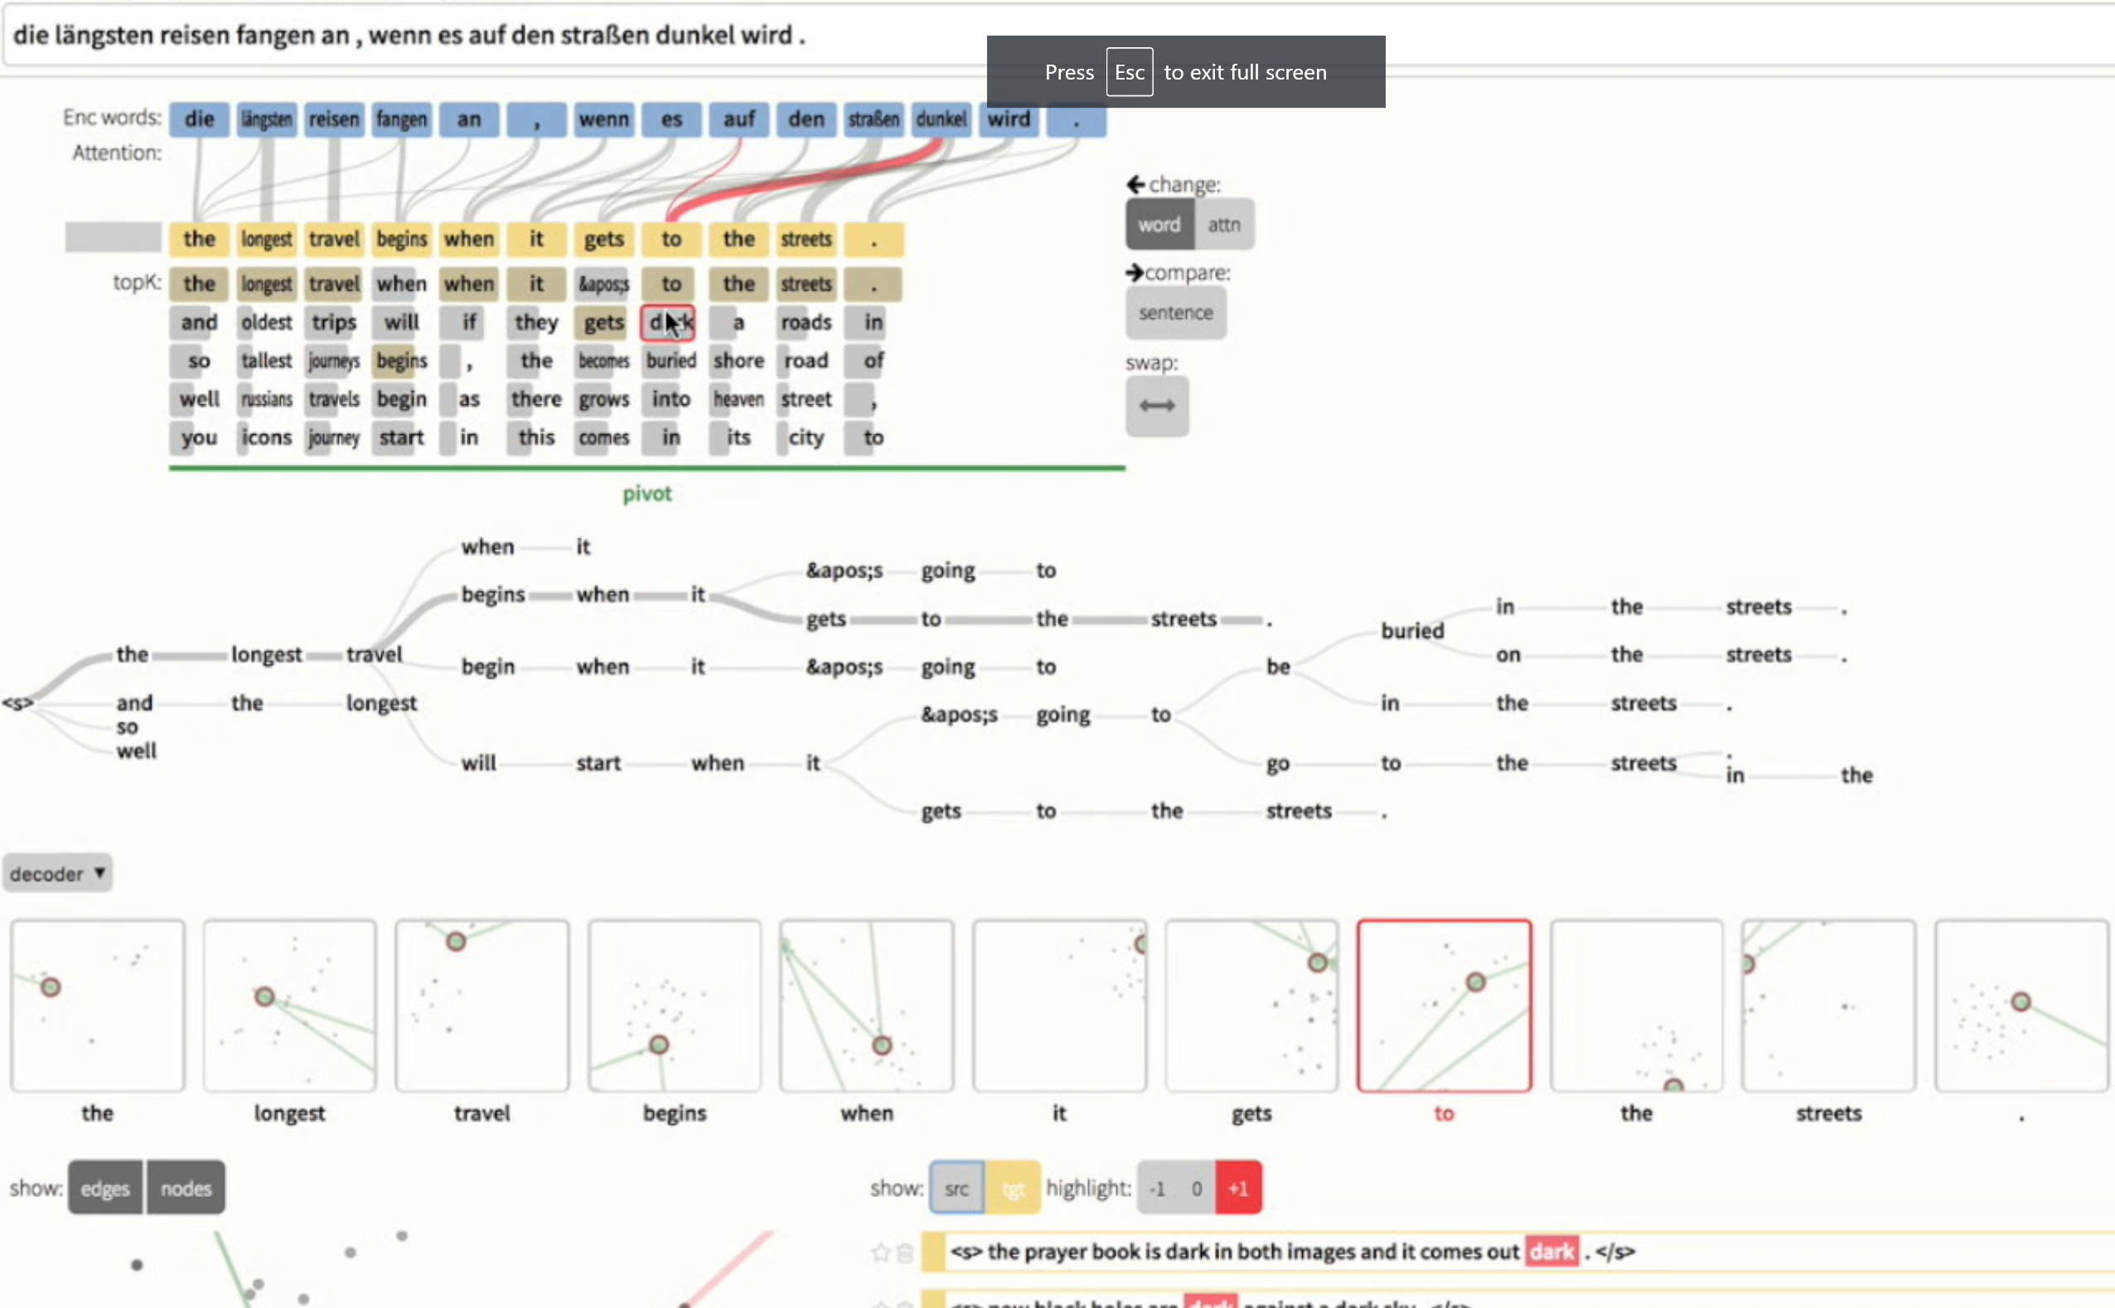
Example #2: Model Debugging
Strobelt et al 2018
https://seq2seq-vis.io/

Slide 42
Wicked Problems of ML
Implementation/Complexity
Model Construction
Model Debugging
Data Quality
Data Debugging
Model Selection
Difficult to Interpret/Explain

Slide 43
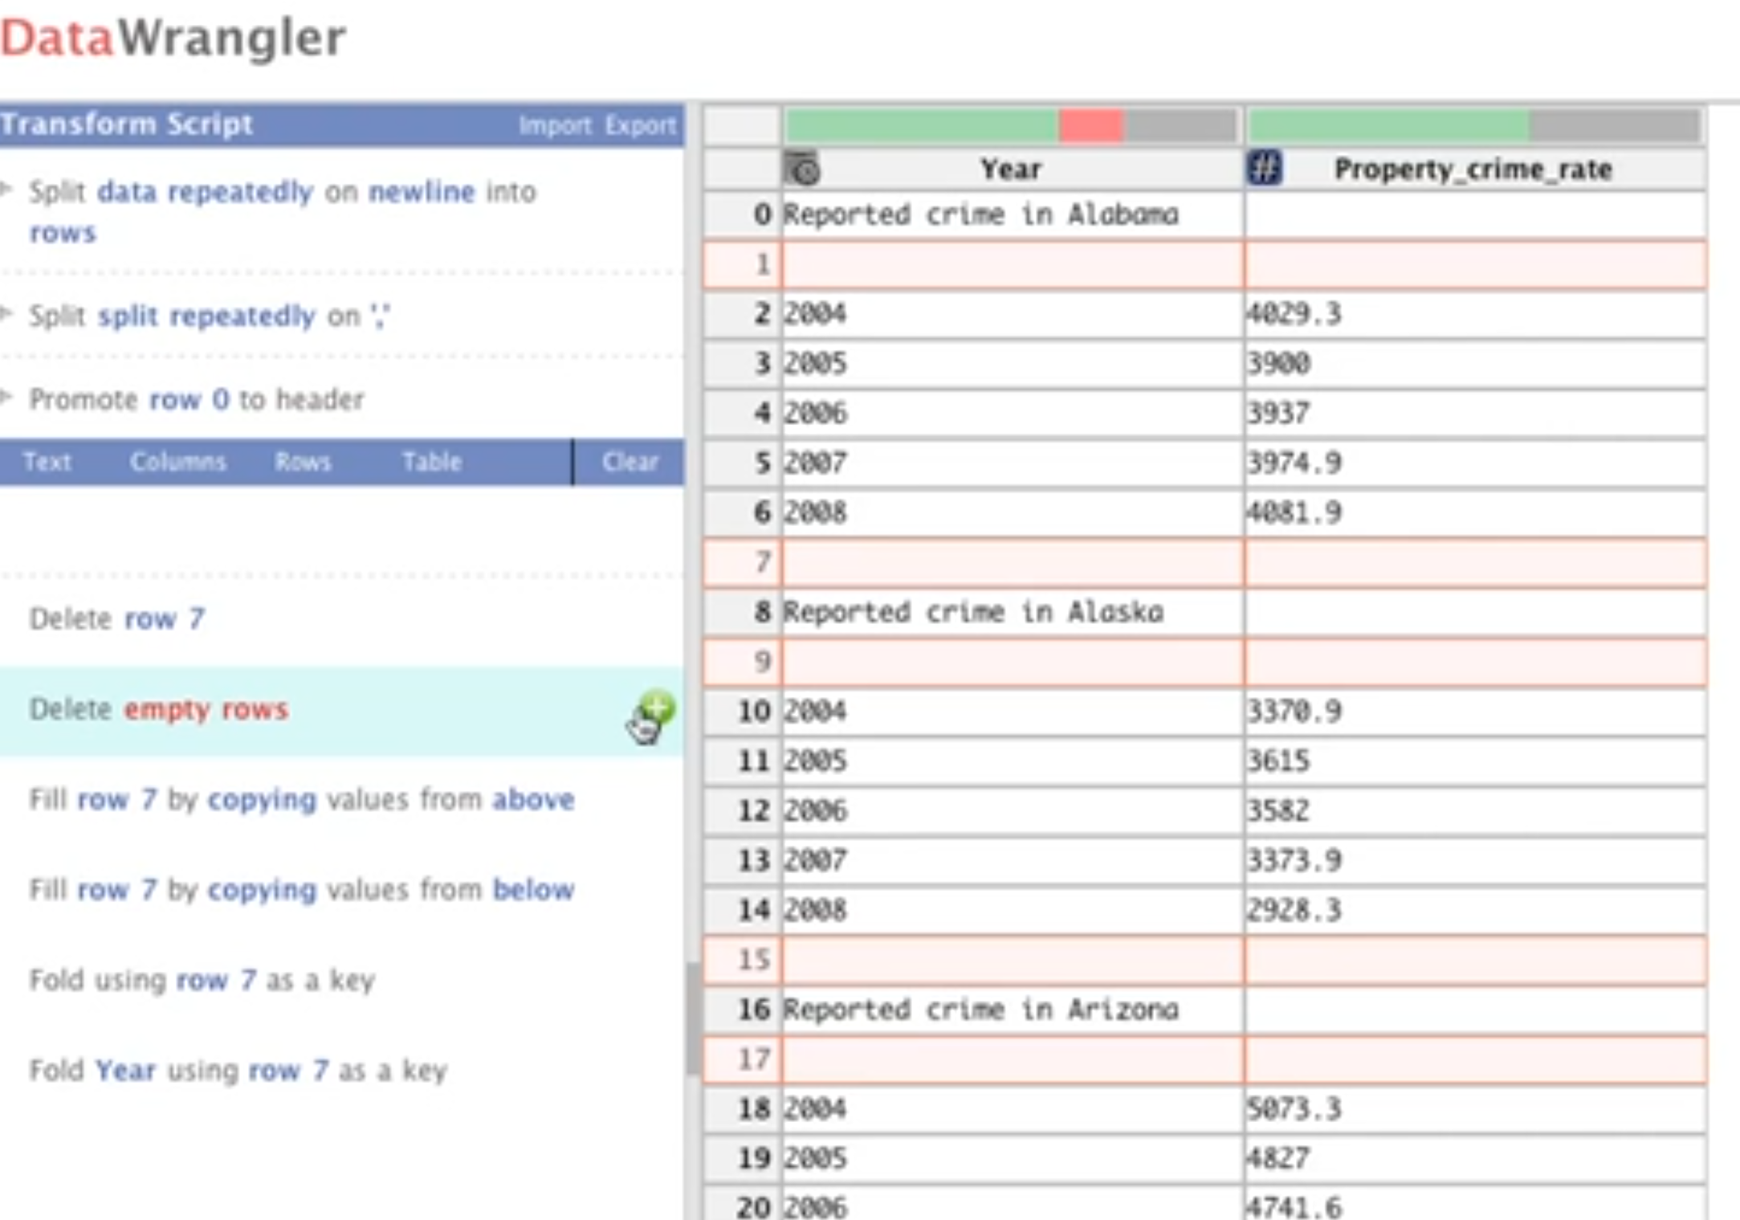
Example #3: Data Debugging
Kandel et al 2011
http://vis.stanford.edu/papers/wrangler

Slide 44
Wicked Problems of ML
Implementation/Complexity
Model Construction
Model Debugging
Data Quality
Data Debugging
Model Selection
Model Steering / Selection
Difficult to Interpret/Explain

Slide 45
Example #4: Model Steering / Selection
Muhlbacher et al 2018

Slide 46
Wicked Problems of ML
Implementation/Complexity
Model Construction
Model Debugging
Data Quality
Data Debugging
Model Selection
Model Steering / Selection
Difficult to Interpret/Explain
Model Explanation

Slide 47
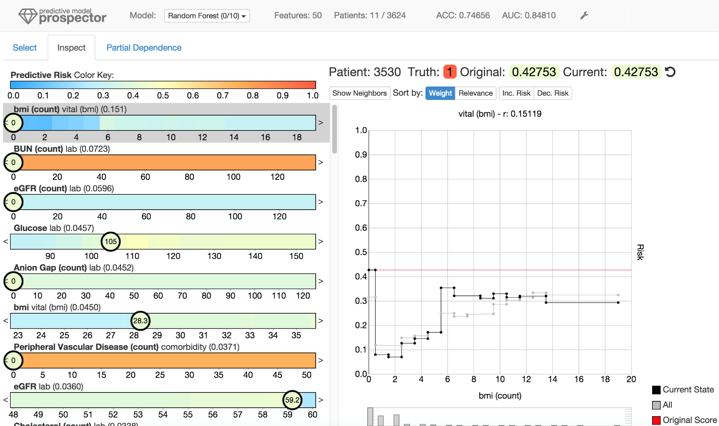
Example #5: Model Explanation
https://josuakrause.github.io/info/prospector.html
Krause et al 2016

Slide 48
Wicked Problems of ML
Implementation/Complexity
Model Construction
Model Debugging
Data Quality
Data Debugging
Model Selection
Model Steering / Selection
Difficult to Interpret/Explain
Model Explanation

Slide 49
Wicked Problems of ML
Implementation/Complexity
Model Construction
Model Debugging
Data Quality
Data Debugging
Model Selection
Model Steering / Selection
Difficult to Interpret/Explain
Model Explanation

Slide 51
The Future of Model Explanation
EU GDPR adopted in 2016
Regulations on data and modeling for all citizens in EU and EEA
Limitations on the use of “automated decision making”
Must involve a human if significant effects on another human
Right to explainability
Right to “meaningful information about the logic involved” and to “the significance and the envisaged consequences” of automated decision-making.
https://www.oreilly.com/radar/how-will-the-gdpr-impact-machine-learning/

Slide 52
The Future of Model Steering
VA systems are hard to make
Require front end, backend, database, etc.
Tend to be one off
But remember the number system?
The right visual encoding opened up so much reasoning

Slide 53
Capacity for learning
Robotic arm @ ~3 hours
Baby Leo @ 8 months
Baby Goat @ ~1 week
Notes:
Think about two things.
First, think about how much harder it is to learn when you have such a wide space to learn in. The continuum from a motorized arm to a mountain goat to a human brain. So when we’re building these complex Ais, it’s worth it to invest the time and work in.
And second, think about the amount of data, the heterogeneity of data, that’s available to a human. Hands, eyes, ears, nose, taste. These things let us experiment. The robotic arm had one input of data – the image of the ball, and then one feedback; whether it hit the ball or not. Real intelligence requires so much more. When I talk about affordances, expert feedback, model steering, it’s not just saying, choose a different parameter for the ML algorithm. It’s providing entirely different dimensions of data back to the intelligence, to help it learn things it never could.

Slide 54
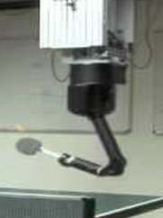
More effort, more data needed for complex tasks
More complex tasks require models with broader capabilities
This requires more data, more effort, and more ways of learning
Traditional ML is still laser-focused on small, quantifiable tasks (CIFAR-10)
Visualization can act as the eyes and ears (and hands) to provide more input to training

Slide 55
Outline
Visual Analytics and why we need ML
High-level overview of ML
Why should visualization help?
Affordances/Abstractions
Five ways VA makes ML more accessible
Model Construction
Model Debugging
Data Debugging
Model Steering / Selection
Model Explanation
Thanks!
Questions?
Notes:
Today, we’re going to do a quick overview of ML and what makes it hard to use. Then, we’ll talk about why visualization might help with these issues.
We’ll finish by looking at 5 ways Visual Analytics has been used to make ML more accessible.

Slide 56
Machine Learning or Traditional Statistics?
Spam Filtering
ML - unstructured text, lots of data, complex rules
Bank Loan
Traditional Stats – need for explanation, simplicity
Facial Recognition
ML – unstructured data (images), lots of it, complex
Patient Data/triaging/diagnoses
?????
Finance, Cybersecurity, Chemistry, Physics
?????

Slide 57
Two Ways to Think About it
Visualization as affordance
Visualization and ML as orthogonal views into the data

Slide 58
Two Ways to Think About it
Visualization as affordance
Visualization and ML as orthogonal views into the data

Slide 59
Two Ways to Think About it
Visualization as affordance
Visualization and ML as orthogonal views into the data

Slide 60
ML Models as Mappings
Machine Learning model as a function
Classification $f:D⇒\left\{0,1\right\}$
Regression $f:D⇒ℝ$
Dimensionality Reduction $f: ℝ^{n}⇒ ℝ^{m}$

Slide 61
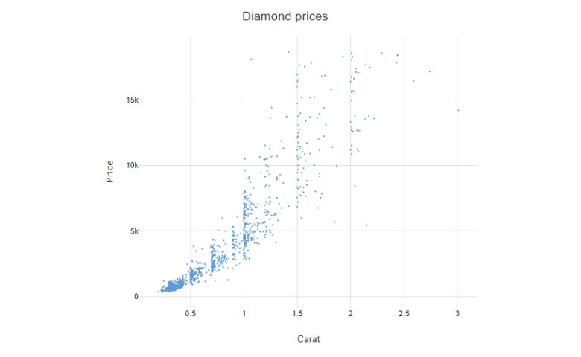
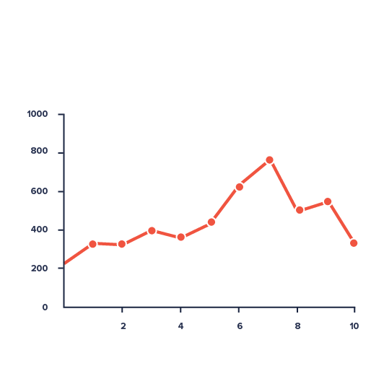
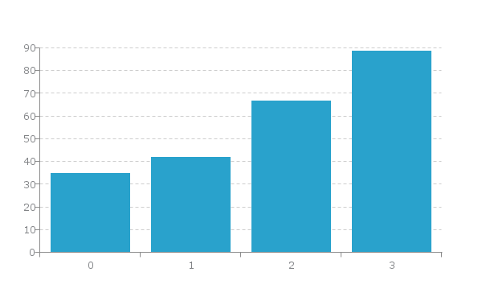
Visualizations as Mappings
$$f:\{D\}⇒ ℝ^{2}$$
$$f:\{D\}⇒ ℝ^{2}$$
$$f:\{D\}⇒ ℝ^{k}$$

Slide 62
ML Models as Mappings
Machine Learning model as a function
Classification $f:D⇒\left\{0,1\right\}$
Regression $f:D⇒ℝ$
Dimensionality Reduction $f: ℝ^{n}⇒ ℝ^{m}$
A lot of data is lost in these mappings!
domain is high-dimensional
target is low-dimensional

Slide 63
Decompose and Analyze
We can decompose the mapping into steps and visualize intermediate representations or residuals

Slide 64
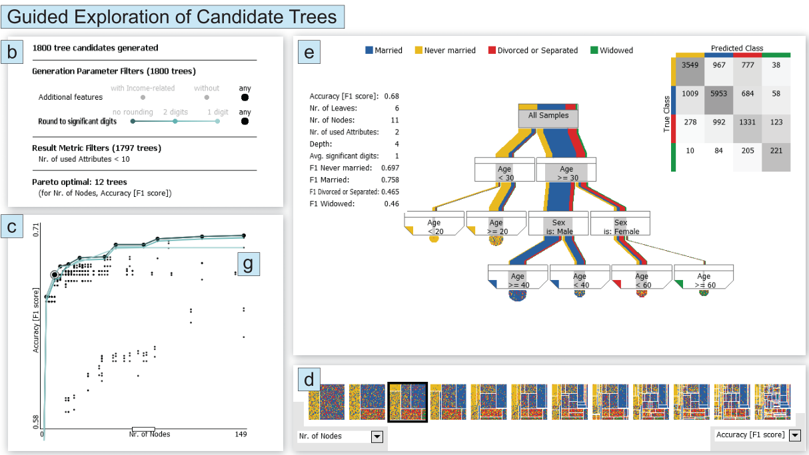
Two Ways to Think About it
Visualization as affordance
Visualization and ML as orthogonal views into the data
In practice,
both used together.
Muhlbacher 2018

