Slide 1
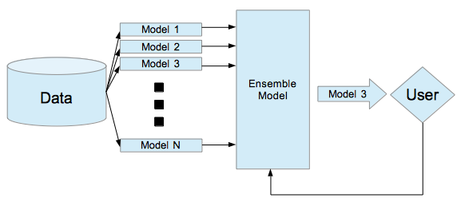
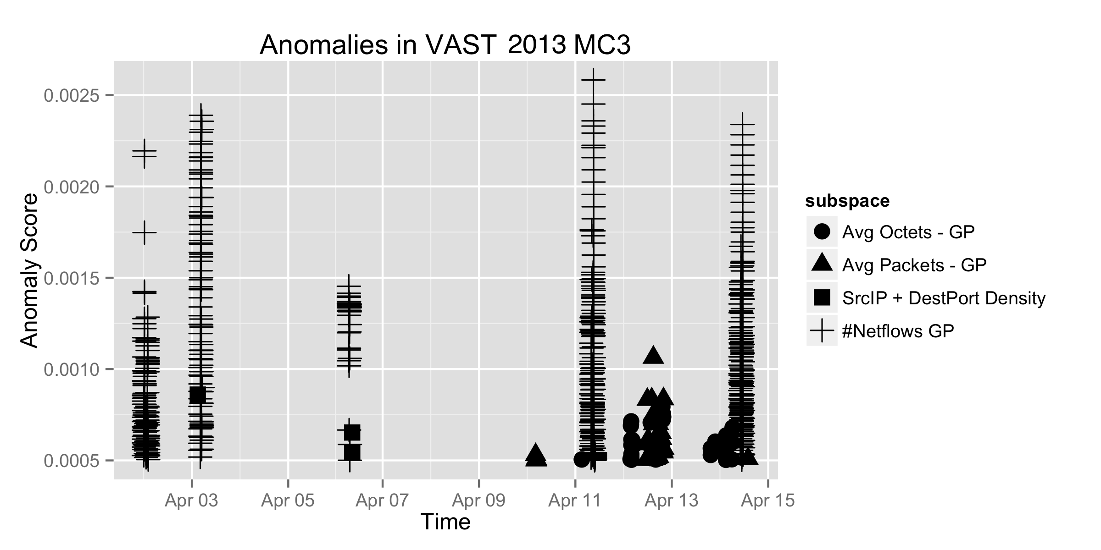
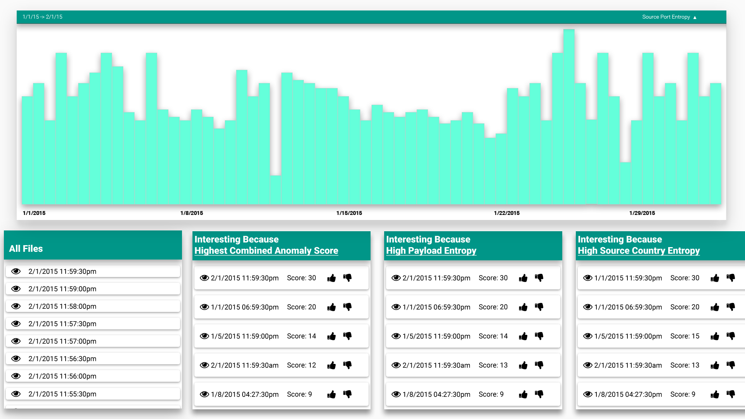
Big Data, Bigger Audience: A Meta-algorithm for Making Machine Learning Actionable for Analysts
Dylan Cashman, Remco Chang
Visual Analytics Lab at Tufts (VALT)
Tufts University
Medford, MA
Stephen Kelley, Diane Staheli, Cody Fulcher, Marianne Procopio
MIT Lincoln Laboratory
Lexington, MA
OVERVIEW
RESEARCH QUESTIONS
IDEA
Analysts lack trust in machine learning algorithms due to high false positive rate, uninterpretable output, and difficulties of tuning.
This is at odds with the increasing velocity of data.
How can we constrain models to have interpretable output?
Are we able to compensate for constraints to have comparable results?
What design decisions are important for analysts?
Use multiple small models, and present the most confident model to the user.
META-ALGORITHM
We generate a large group of simple models that cover orthogonal sections of the data with the assumption that this model mesh approximates a more complex model.
To generate this model mesh, we partition the data into 1- and 2-dimension subspaces, and for each subspace, we train several types of machine learning models, including forecasting and clustering.
These models are chosen with two priority: they should be orthogonal in that they should cover different qualities of the data, and they should have some interpretable output.
Then, we utilize techniques from ensemble learning to integrate these models into a single model for the data task at hand.
In practice, while we give up some capability by limiting ourselves to small subspaces, many machine learning tasks have high accuracy when small subspaces are used in concert.
To illustrate this, we used our meta-algorithm on the VAST 2013 network traffic data, and showed that different events showed up in different subspaces of our anomaly detector.
CASE STUDY
To demonstrate the effectiveness of this meta-algorithm, we built a system to aid cybersecurity analysts in a data analysis task. This tool analyzed packet data from approximately 450 hosts in a private corporate network. In this system, we were able to successfully integrate the following design guidelines.
Assist the analyst in an unobtrusive, clear manner
Have enough statistical power to cue the analyst to new insights
Have clear, interpretable output to increase trust in the statistical models used
Allow analysts easy access to underlying raw data to confirm any suggested insights
Use implicit feedback from the user to correct the system’s combination of small models
An intrusion detection system built to assist analysts in identifying post-hoc intrusions in network traffic. Our meta-algorithm is used to identify potentially anomalous 30-second windows, and the most significant subspaces are suggested to the user. User feedback is used to implicitly tune and calibrate the combining of the multiple small models.

